Slide 1
Chapter 2 – Economics: The Framework for Business

Slide 2
Learning Outcomes
Define economics and discuss the evolving global economic crisis
Analyze the impact of fiscal and monetary policy on the economy
Explain and evaluate the free market system and supply and demand
Explain and evaluate planned market systems
Describe the trend toward mixed market systems
Discuss key terms and tools to evaluate economic performance

Slide 3
Understanding Economics
LO 1
Economy: Financial and social system of how resources flow through society
Economics: Study of the choices made by people, companies, and governments to allocate society’s resources
Macroeconomics: Study of a country’s overall economic dynamics
Microeconomics: Study of smaller economic units

Slide 4
Global Economic Crisis
LO 1
Began when the dot-com bubble burst in 2000, followed by the 9/11 terrorist attacks in 2001
Stock market dropped, unemployment rate increased, and the economy was on the brink of recession
Subprime mortgage loans - Granted to borrowers with low credit scores
Provided lenders higher return than many other investments

Slide 5
Global Economic Crisis (continued)
LO 1
As housing prices peaked in 2006, borrowers owed their lenders more than the value of their homes
Eventually led to the collapse of financial institutions

Slide 6
Global Economic Crisis - Economic Relief
LO 1
Troubled Assets Relief Program (TARP)
Introduced as an economic bailout plan
Government passed the American Recovery and Reinvestment Act to help the nation recover from a financial disaster
Included cutting taxes, building infrastructure, and investing in green energy

Slide 7
Fiscal Policy
LO 2
Government efforts to influence the economy through taxation and spending
Designed to encourage growth, boost employment, and curb inflation
Increasing the debt ceiling in 2011 created the fiscal cliff
Debt ceiling - Maximum amount Congress lets the government borrow
Fiscal cliff - Across-the-board spending cuts and sharp tax hikes to decrease the U.S. budget deficit

Slide 8
Outcomes of Budget
LO 2
Budget surplus
Overage that occurs when revenue is higher than expenses over a given period of time
Budget deficit
Shortfall that occurs when expenses are higher than revenue over a given period of time
Federal debt
Sum of all the money that the federal government has borrowed over the years and not yet repaid

Slide 9
Monetary Policy
LO 2
Federal Reserve decisions that shape the economy by influencing interest rates and the supply of money
Functions of the Federal Reserve
Bailing out shaky firms during a financial crisis
Providing banking services for member banks and the federal government
Managing the U.S. monetary policy

Slide 10
Purpose of the Federal Reserve
LO 2
To influence the size of the money supply
M1 money supply: Includes all currency plus checking accounts and traveler’s checks
M2 money supply: Includes all M1 money supply plus most saving accounts, money market accounts, and certificates of deposit

Slide 11
Tools Used by the Federal Reserve to Expand and Contract Money Supply
LO 2
Open market operations
Federal Reserve function of buying and selling government securities
Discount rate
Rate of interest that the Federal Reserve charges when it loans funds to banks
Reserve requirement
Rule set by the Federal Reserve, which specifies the minimum amount of reserves a bank is required to hold

Slide 12
Capitalism
LO 3
Economic system based on private ownership, economic freedom, and fair competition
Paramount importance is given to individuals, innovation, and hard work
Individuals, businesses, or non-profit organizations privately own the vast majority of enterprises (with only a small fraction owned by the government)

Slide 13
Fundamental Rights of Capitalism
LO 3
Right to own a business and keep after-tax profits
Right to private property
Right to free choice
Right to fair competition

Slide 14
Degrees of Competition
LO 3
Pure competition: Many competitors selling virtually identical products
Monopolistic competition: Many competitors selling differentiated products
Oligopoly: Handful of competitors selling products that can be similar or different

Slide 15
Degrees of Competition (continued)
LO 3
Monopoly: Single producer dominating the industry, leaving no room for competitors
Natural monopoly arises when a single supplier is more efficient than multiple, competing ones

Slide 16
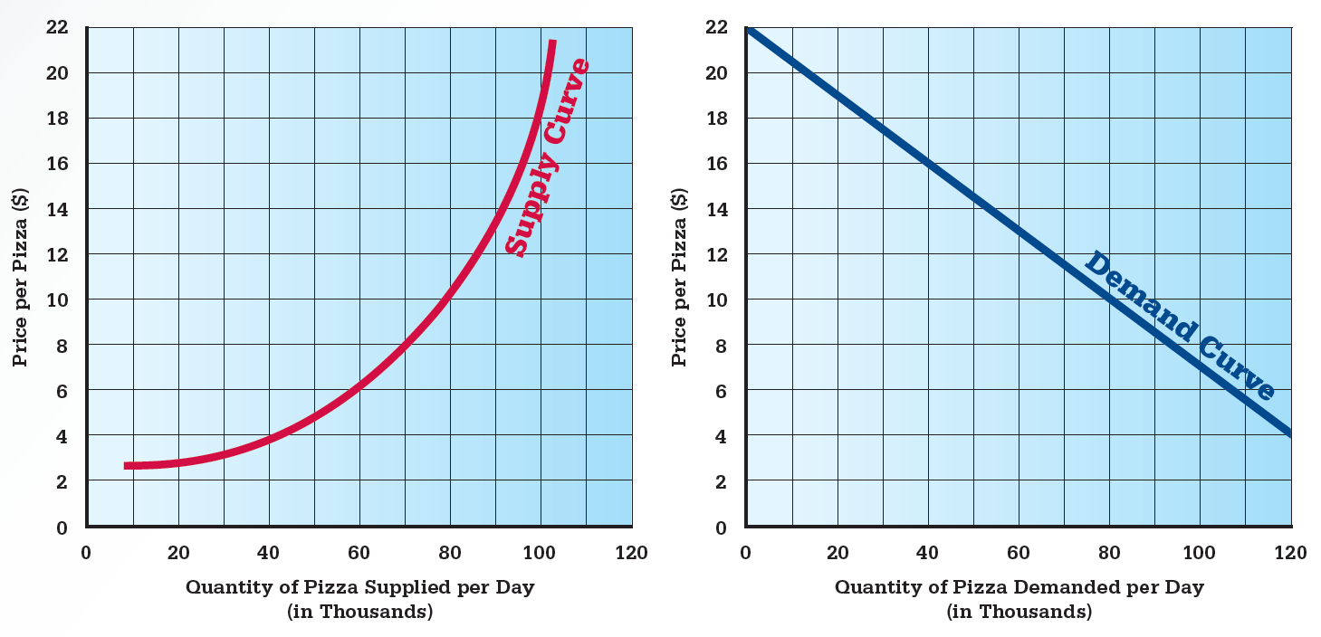
2.3 Supply Curve and Demand Curve
LO 3

Slide 17
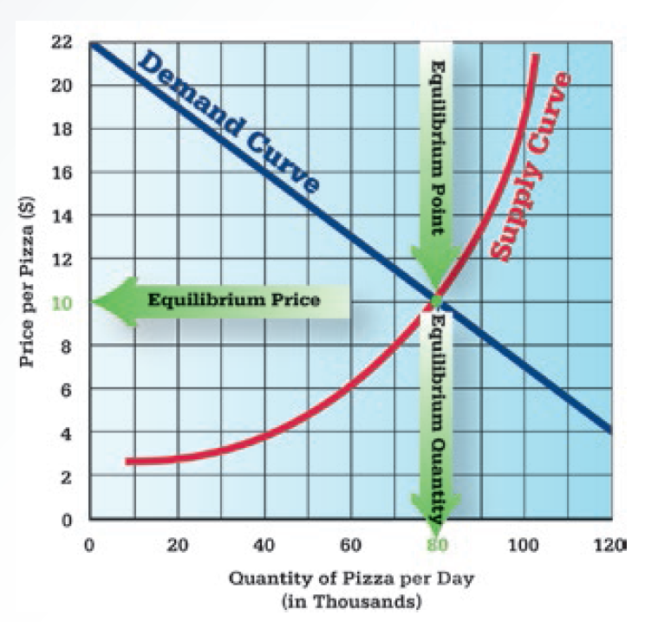
2.4 Equilibrium Price
LO 3

Slide 18
Planned Economies
LO 4
Socialism: Government owns and operates key enterprises that directly affect public welfare
Communism: Calls for public ownership of all enterprises under the direction of a strong central government

Slide 19
Mixed Economies
LO 5
Embody elements of planned and market-based economic systems
Help in meeting the needs of the citizens
Government-owned businesses have turned to privatization
Privatization: Process of converting government-owned businesses to private ownership

Slide 20
Evaluating Economic Performance - Gross Domestic Product (GDP)
LO 6
Total value of all final goods and services produced within a nation’s physical boundaries over a given period of time
Vital measure of economic health
Measures the economic performance of individual nations
Compares the growth among nations

Slide 21
Evaluating Economic Performance - Employment Level
LO 6
Unemployment rate: Percentage of people in the labor force over age 16 who do not have jobs and are seeking employment
Frictional unemployment - When it is possible to find better jobs
Structural unemployment - Unemployment for a longer term as skills are no longer relevant

Slide 22
Evaluating Economic Performance - Employment Level (continued)
LO 6
Cyclical unemployment - Layoffs during recessions
Seasonal unemployment - Job loss related to the time of year

Slide 23
Evaluating Economic Performance - Business Cycle
LO 6
Periodic contraction and expansion of the economy
Contraction: Period of economic downturn marked by rising unemployment
Recession: Marked by a decrease in the GDP for two consecutive quarters
Depression: Long-lasting recession
Recovery: Period of rising economic growth and employment
Expansion: Period of strong economic growth and high employment

Slide 24
Evaluating Economic Performance - Price Levels
LO 6
Measure used to evaluate economic well-being
Inflation: Period of rising average prices across the economy
Hyperinflation: Average monthly inflation rate of more than 50 percent
Disinflation: Period of slowing average price increases
Deflation: Period of falling average prices

Slide 25
Evaluating Economic Performance - Inflation and Productivity
LO 6
Price indexes used to evaluate inflation
Consumer price index (CPI): Evaluates the change in the weighted-average price of goods and services that an average consumer buys each month
Producer price index (PPI): Evaluates the change over time in the weighted-average wholesale prices
Productivity: Relationship between the production of goods and services and the resources required to produce them

Slide 26
Key terms
Economy
Economics
Macroeconomics
Microeconomics
Fiscal policy
Budget surplus
Budget deficit
Federal debt
Monetary policy
Commercial banks
Money supply
Money
M1 money supply
M2 money supply
Open market operations
Federal Deposit Insurance Corporation (FDIC)

Slide 27
Key terms (continued 1)
Discount rate
Reserve requirement
Economic system
Capitalism
Pure competition
Monopolistic competition
Oligopoly
Monopoly
Natural monopoly
Supply
Supply curve
Demand
Demand curve
Equilibrium price
Socialism
Communism
Mixed economies

Slide 28
Key terms (continued 2)
Privatization
Gross domestic product
Unemployment rate
Business cycle
Contraction
Recession
Depression
Recovery
Expansion
Inflation
Hyperinflation
Disinflation
Deflation
Consumer price index (CPI)
Producer price index (PPI)
Productivity

Slide 29
Summary
Economics is the study of choices made to allocate society’s resources
Fiscal and monetary policies are used to improve economic performance
Socialism and communism are two categories of planned economies
Economies of the world are adopting mixed market systems to meet the needs of its citizens

Slide 30
Chapter 02

