Slide 1
Regents Park Publishers
Operations Management
T1LM2
Ethics Sustainability Externalities

Slide 2
Ethics, Sustainability, and Externalities

Slide 3
Ethics and Operations Management
Management must deliver healthy, safe, honest quality products and services
Dishonesty risks injuries, lawsuits, recalls, and increased oversight and regulations
Organizations are judged based on the degree of externalities they create (positive and negative)
Organizations are also judged by how they respond to problems (i.e.:Tylenol, Ford Pinto, Deep Water Horizon, VW, Toyota Prius, Lehman Bros.)

Slide 4
Definition
A consequence of an economic activity that is experienced by unrelated third parties. An externality can be either positive or negative.
Pollution emitted by a factory that spoils the surrounding environment and affects the health of nearby residents is an example of a negative externality.
An example of a positive externality is the effect of a well-educated labor force on the productivity of a company

Slide 5
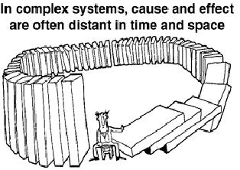
Perspective One

Slide 6
Perspective Two
In complex systems, cause and effect are often distance in time and space.

Slide 7
Video References
Milton Friedman
E-waste Hell
Pacific Trash Vortex
Unintended Consequences
Externalities

Slide 8
Regents Park Publishers
T1LM2
End

