Slide 1

Regents Park Publishers
Operations Management
T3LM3
Supply Chain Analytics

Slide 2
Supply Chain Management

Slide 3
The Strategic Importance of the Supply Chain
Supply-chain management is the integration of the activities that procure materials and services, transform them into intermediate goods and the final product, and deliver them to customers
Competition is no longer between companies; it is between supply chains

Slide 4
Supply-Chain Management
Important activities include determining
Transportation vendors
Credit and cash transfers
Suppliers
Distributors and banks
Accounts payable and receivable
Warehousing and inventory
Order fulfillment
Sharing customer, forecasting, and production information

Slide 5
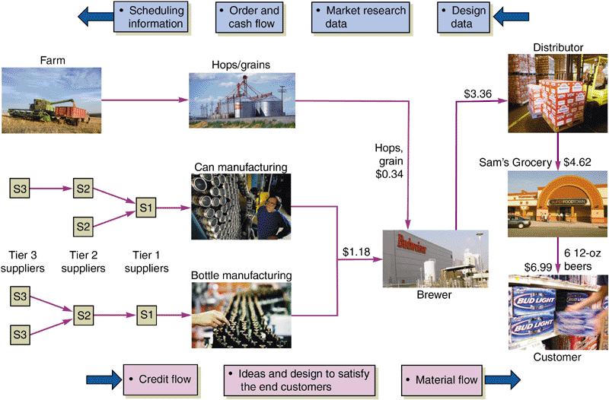
A Supply Chain

Slide 6
Global Supply-Chain Issues
Supply chains in a global environment must be able to
React to sudden changes in parts availability, distribution, or shipping channels, import duties, and currency rates
Use the latest computer and transmission technologies to schedule and manage the shipment of parts in and finished products out
Staff with local specialists who handle duties, freight, customs and political issues

Slide 7
How Supply-Chain Decisions Impact Strategy
 | Low-Cost Strategy | Response Strategy | Differentiation Strategy
Supplier’s Goal | Supply demand at lowest possible cost (e.g., Emerson Electric, Taco Bell) | Respond quickly to changing requirements and demand to minimize stockouts (e.g., Dell Computers) | Share market research; jointly develop products and options (e.g., Benetton)
Primary Selection Criteria | Select primarily for cost | Select primarily for capacity, speed, and flexibility | Select primarily for product development skills

Slide 8
How Supply-Chain Decisions Impact Strategy
 | Low-Cost Strategy | Response Strategy | Differentiation Strategy
Process Charact-eristics | Maintain high average utilization | Invest in excess capacity and flexible processes | Modular processes that lend themselves to mass customization
Inventory Charact-eristics | Minimize inventory throughout the chain to hold down cost | Develop responsive system with buffer stocks positioned to ensure supply | Minimize inventory in the chain to avoid obsolescence

Slide 9
How Supply-Chain Decisions Impact Strategy
 | Low-Cost Strategy | Response Strategy | Differentiation Strategy
Lead-Time Charact-eristics | Shorten lead time as long as it does not increase costs | Invest aggressively to reduce production lead time | Invest aggressively to reduce development lead time
Product-Design Charact-eristics | Maximize performance and minimize costs | Use product designs that lead to low setup time and rapid production ramp-up | Use modular design to postpone product differentiation as long as possible

Slide 10
Supply Chain Economics

Slide 11
Supply-Chain Economics
Supply Chain Costs as a Percent of Sales
Industry | % Purchased
All industry | 52
Automobile | 67
Food | 60
Lumber | 61
Paper | 55
Petroleum | 79
Transportation | 62

Slide 12
Supply-Chain Economics
Dollars of additional sales needed to equal $1 saved through the supply chain
Percent of Sales Spent in the Supply Chain
Percent Net Profit
of Firm 40% 50% 60% 70% 80% 90%
2 $3.23 $3.85 $4.76 $6.25 $9.09 $16.67
4 $3.13 $3.70 $4.55 $5.88 $8.33 $14.29
6 $3.03 $3.57 $4.35 $5.56 $7.69 $12.50
8 $2.94 $3.45 $4.17 $5.26 $7.14 $11.11
10 $2.86 $3.33 $4.00 $5.00 $6.67 $10.00

Slide 13
Make-or-Buy Decisions
Reasons for Making
Maintain core competence
Lower production cost
Unsuitable suppliers
Assure adequate supply (quantity or delivery)
Utilize surplus labor or facilities
Obtain desired quality
Remove supplier collusion
Obtain unique item that would entail a prohibitive commitment for a supplier
Protect personnel from a layoff
Protect proprietary design or quality
Increase or maintain size of company

Slide 14
Make-or-Buy Decisions
Reasons for Buying
Frees management to deal with its primary business
Lower acquisition cost
Preserve supplier commitment
Obtain technical or management ability
Inadequate capacity
Reduce inventory costs
Ensure alternative sources
Inadequate managerial or technical resources
Reciprocity
Item is protected by a patent or trade secret

Slide 15
Outsourcing
Transfers traditional internal activities and resources of a firm to outside vendors
Utilizes the efficiency that comes with specialization
Firms outsource information technology, accounting, legal, logistics, and production

Slide 16
Ethics in Supply Chain

Slide 17
Ethics in the Supply Chain
Opportunities for unethical behavior are enormous and temptations are high
Many companies have strict rules and codes of conduct that define acceptable behavior
Institute for Supply Management has developed a detailed set of principles and standards for ethical behavior

Slide 18
Ethical Supply Management
Avoid the intent and appearance of unethical or compromising practice in relationships, actions, and communications
Demonstrate loyalty to the employer by diligently following the lawful instructions of the employer, using reasonable care and granted authority
Avoid any personal business or professional activity that would create a conflict between personal interests and the interests of the employer

Slide 19
Ethical Supply Management
Avoid soliciting or accepting money, loans, credits, or preferential discounts, and the acceptance of gifts, entertainment, favors, or services from present or potential suppliers that might influence, or appear to influence, supply management decisions
Handle confidential or proprietary information with due care and proper consideration of ethical and legal ramifications and government regulations
Promote positive supplier relationships through courtesy and impartiality
Avoid improper reciprocal agreements

Slide 20
Ethical Supply Management
Know and obey the letter and spirit of laws applicable to supply management
Encourage support for small, disadvantaged, and minority-owned businesses
Acquire and maintain professional competence
Conduct supply management activities in accordance with national and international laws, customs, and practices, your organization’s policies, and these ethical principles and standards of conduct
Enhance the stature of the supply management profession

Slide 21
Supply Chain Strategies

Slide 22
Supply-Chain Strategies
Negotiating with many suppliers
Long-term partnering with few suppliers
Vertical integration
Keiretsu
Virtual companies that use suppliers on an as needed basis

Slide 23
Many Suppliers
Commonly used for commodity products
Purchasing is typically based on price
Suppliers are pitted against one another
Supplier is responsible for technology, expertise, forecasting, cost, quality, and delivery

Slide 24
Few Suppliers
Buyer forms longer term relationships with fewer suppliers
Create value through economies of scale and learning curve improvements
Suppliers more willing to participate in JIT programs and contribute design and technological expertise
Cost of changing suppliers is huge

Slide 25
Vertical Integration
Vertical Integration Examples of Vertical Integration
Raw Material | Iron ore | Silicon | Farming
Backward integration | Steel
Current transformation | Automobiles | Integrated circuits | Flour milling
Forward integration | Distribution systems | Circuit boards
Finished goods (customers) | Dealers | Computers Watches Calculators | Baked goods

Slide 26
Vertical Integration
Developing the ability to produce goods or service previously purchased
Integration may be forward, towards the customer, or backward, towards suppliers
Can improve cost, quality, and inventory but requires capital, managerial skills, and demand
Risky in industries with rapid technological change

Slide 27
Keiretsu Networks
A middle ground between few suppliers and vertical integration
Supplier becomes part of the company coalition
Often provide financial support for suppliers through ownership or loans
Members expect long-term relationships and provide technical expertise and stable deliveries
May extend through several levels of the supply chain

Slide 28
Virtual Companies
Rely on a variety of supplier relationships to provide services on demand
Fluid organizational boundaries that allow the creation of unique enterprises to meet changing market demands
Exceptionally lean performance, low capital investment, flexibility, and speed

Slide 29
Managing the Supply Chain
There are significant management issues in controlling a supply chain involving many independent organizations
Mutual agreement on goals
Trust
Compatible organizational cultures

Slide 30
Issues in an Integrated Supply Chain
Local optimization - focusing on local profit or cost minimization based on limited knowledge
Incentives (sales incentives, quantity discounts, quotas, and promotions) - push merchandise prior to sale
Large lots - low unit cost but do not reflect sales
Bullwhip effect - stable demand becomes lumpy orders through the supply chain

Slide 31
Opportunities in an Integrated Supply Chain
Accurate “pull” data
Lot size reduction
Single stage control of replenishment
Vendor managed inventory
Postponement

Slide 32
Opportunities in an Integrated Supply Chain
Channel assembly
Drop shipping and special packaging
Blanket orders
Standardization
Electronic ordering and funds transfer

Slide 33
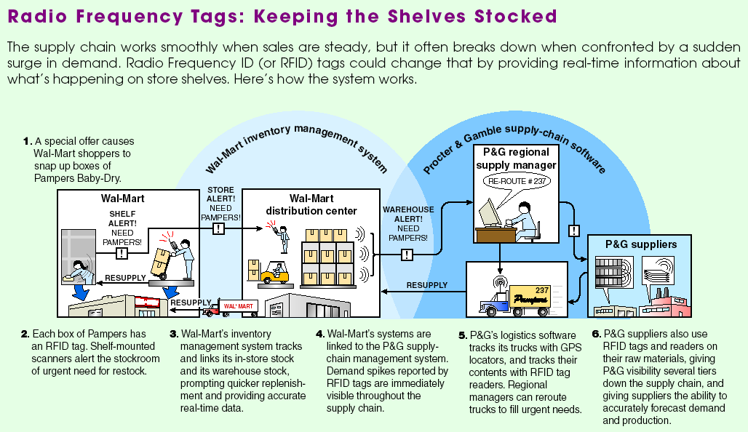
Radio Frequency Tags

Slide 34
Vendor Selection

Slide 35
Vendor Selection
Vendor evaluation
  Critical decision
  Find potential vendors
  Determine the likelihood of them becoming good suppliers
Vendor Development
  Training
  Engineering and production help
  Establish policies and procedures

Slide 36
Vendor Selection
Negotiations
  Cost-Based Price Model - supplier opens books to purchaser
  Market-Based Price Model - price based on published, auction, or indexed price
  Competitive Bidding - used for infrequent purchases but may make establishing long-term relationships difficult

Slide 37
Vendor Evaluation
Criteria | Weights | Scores (1-5) | Weight x Score
Engineering/research/innovation skills | .20 | 5 | 1.0
Production process capability (flexibility/technical assistance) | .15 | 4 | .6
Distribution/delivery capability | .05 | 4 | .2
Quality systems and performance | .10 | 2 | .2
Facilities/location | .05 | 2 | .1
Financial and managerial strength (stability and cost structure) | .15 | 4 | .6
Information systems capability (e-commerce, Internet) | .10 | 2 | .2
Integrity (environmental compliance/ ethics) | .20 | 5 | 1.0
Total | 1.00 |  | 3.9

Slide 38
Logistics & Distribution Management

Slide 39
Logistics Management
Objective is to obtain efficient operations through the integration of all material acquisition, movement, and storage activities
A frequent candidate for outsourcing
Gain competitive advantage through reduced costs and improved customer service

Slide 40
Distribution Systems
Trucking
  Moves the vast majority of manufactured goods
  Chief advantage is flexibility
Railroads
  Capable of carrying large loads
  Little flexibility though containers and piggybacking have helped with this

Slide 41
Distribution Systems
Airfreight
  Fast and flexible for light loads
  May be expensive
Waterways
  Typically used for bulky, low-value cargo
  Used when shipping cost is more important than speed

Slide 42
Distribution Systems
Pipelines
  Used for transporting oil, gas, and other chemical products

Slide 43
Analytics of
Supply Chain Management

Slide 44
Cost of Shipping Alternatives
Product in transit is a form of inventory and has a carrying cost
Faster shipping is generally more expensive than slower shipping
We can evaluate the two costs to better understand the trade-off

Slide 45
Cost of Shipping Alternatives
Value of connectors = $1,750.00
Holding cost = 40% per year
Second carrier is 1 day faster and $20 more expensive
annual holding cost
Daily cost of holding product
product value
= x /365
= (.40 x $1,750)/ 365 = $1.92
Since it costs less to hold the product one day longer than it does for the faster shipping ($1.92 < $20), we should use the cheaper, slower shipper

Slide 46
Logistics, Security, and JIT
Borders are becoming more open in the U.S. and around the world
Monitoring and controlling stock moving through supply chains is more important than ever
New technologies are being developed to allow close monitoring of location, storage conditions, and movement

Slide 47
Benchmarking Supply-Chain Management
 | Typical Firms | Benchmark Firms
Administrative costs as a percent of purchases | 3.3% | .8%
Lead time (weeks) | 15 | 8
Time spent placing an order | 42 minutes | 15 minutes
Percentage of late deliveries | 33% | 2%
Percentage of rejected material | 1.5% | .0001%
Number of shortages per year | 400 | 4

Slide 48
Sub-contracting
Outsourcing
Offshoring

Slide 49
Outsourcing
Outsourcing can replace entire purchasing, information systems, marketing, finance, and operations department
Applicable to firms throughout the world
Making the right decision may be the difference between success and failure
Notes:
Points which might be emphasized include:
- Statistical process control measures the performance of a process, it does not help to identify a particular specimen produced as being “good” or “bad,” in or out of tolerance.
- Statistical process control requires the collection and analysis of data - therefore it is not helpful when total production consists of a small number of units
- While statistical process control can not help identify a “good” or “bad” unit, it can enable one to decide whether or not to accept an entire production lot. If a sample of a production lot contains more than a specified number of defective items, statistical process control can give us a basis for rejecting the entire lot. The issue of rejecting a lot which was actually good can be raised here, but is probably better left to later.

Slide 50
What is Outsourcing?
Procuring from external suppliers service or products that are normally part of an organization
Offshoring is moving processes to a foreign country but retaining control
Extension of the long-standing practice of subcontracting
Notes:
Points which might be emphasized include:
- Statistical process control measures the performance of a process, it does not help to identify a particular specimen produced as being “good” or “bad,” in or out of tolerance.
- Statistical process control requires the collection and analysis of data - therefore it is not helpful when total production consists of a small number of units
- While statistical process control can not help identify a “good” or “bad” unit, it can enable one to decide whether or not to accept an entire production lot. If a sample of a production lot contains more than a specified number of defective items, statistical process control can give us a basis for rejecting the entire lot. The issue of rejecting a lot which was actually good can be raised here, but is probably better left to later.

Slide 51
What is Outsourcing?
Outsourcing has become a major strategy as firms move toward specialization
  Increasing expertise
  Reduced cost of reliable transportation
  Rapid deployment of telecommunications and computers
  – the Internet
Notes:
Points which might be emphasized include:
- Statistical process control measures the performance of a process, it does not help to identify a particular specimen produced as being “good” or “bad,” in or out of tolerance.
- Statistical process control requires the collection and analysis of data - therefore it is not helpful when total production consists of a small number of units
- While statistical process control can not help identify a “good” or “bad” unit, it can enable one to decide whether or not to accept an entire production lot. If a sample of a production lot contains more than a specified number of defective items, statistical process control can give us a basis for rejecting the entire lot. The issue of rejecting a lot which was actually good can be raised here, but is probably better left to later.

Slide 52

Examples of Outsourcing
Call centers for Brazil in Angola
Legal and finance service in the Philippines
IBM providing travel and
payroll for P&G
ADP processing payroll
for thousands of firms
Blue Cross sending
patients to India

Slide 53
Types of Outsourcing
Common processes outsourced are
Purchasing
Logistics
R&D
Operations
Service management
Human resources
Finance/accounting
Customer relations
Sales/marketing
Training
Legal processes
Outsourcing implies a legally binding contract

Slide 54
Desirable Outsourcing Destinations
Rank | Country | Score |  | Rank | Country | Score
1 | India | 6.9 |  | 46 | Ukraine | 4.9
2 | China | 6.6 |  | 47 | France | 4.9
3 | Malaysia | 6.1 |  | 48 | Turkey | 4.8
4 | Thailand | 6.0 |  | 49 | Portugal | 4.8
5 | Brazil | 5.9 |  | 50 | Ireland | 4.2

Slide 55
Strategic Planning and
Core Competencies
Strategic planning defines the mission and goals for the organization
From this the organization determines the role of each business activity
Core competencies are things the organization does better than its competition
Non-core activities are good candidates for outsourcing

Slide 56
Strategic Planning and
Core Competencies
Sony,
An Outsourcing Company
Outsourcers
could
provide
Post-sales service
Financial functions
Logistics
Parts manufacture
Core
Competency
Best in the world at electromechanical miniaturization design
Distribution
Marketing
Accounting
Employee benefit management
Maintenance
Real estate management

Slide 57
Theory of Comparative Advantage
If an external outsourcing provider can perform activities more productively than the client firm, the outsourcing provider should do the work
This applies regardless of the geographical location

Slide 58
Outsourcing Trends and Political Repercussions
According to a survey of 53 major corporations, the most important reasons for outsourcing are:
Cost savings 77%
Gaining outside expertise 70%
Improving services 61%
Focusing on core competencies 59%
Gaining access to technology 56%

Slide 59
Outsourcing Trends and Political Repercussions
Outsourcing includes specific business functions (computer help desks) and entire departments (accounting, marketing, finance, etc.)
35% of businesses said they would continue or expand outsourcing
40% said they would continue outsourcing but revise their arrangements
Some said they would reduce outsourcing

Slide 60
Outsourcing Trends and Political Repercussions
Outsourcing includes specific business functions (computer help desks) and entire departments (accounting, marketing, finance, etc.)
35% of businesses said they would continue or expand outsourcing
40% said they would continue outsourcing but revise their arrangements
Some said they would reduce outsourcing

Slide 61
Outsourcing Trends and Political Repercussions
Outsourcing includes specific business functions (computer help desks) and entire departments (accounting, marketing, finance, etc.)
35% of businesses said they would continue or expand outsourcing
40% said they would continue outsourcing but revise their arrangements
Some said they would reduce outsourcing

Slide 62
Outsourcing Trends and Political Repercussions
Not all outsourcing experiences are satisfactory
There is still a lot to learn about outsourcing as a method to improve productivity

Slide 63
Outsourcing Trends and Political Repercussions
Political backlash can occur when jobs are outsourced to foreign countries
  In the U.S. state and federal laws have been enacted to limit or prevent outsourcing activities
Recent data suggests more foreigners outsource jobs to the U.S. than American companies outsource offshore
Backsourcing describes the process of returning work to the original firm when outsourcing fails

Slide 64
Risks of Outsourcing
Outsourcing can be risky
As many as half of all outsourcing agreements fail because of inappropriate planning and analysis
Erratic power grids, government difficulties, inexperienced managers, and unmotivated labor can create problems
Failure to achieve unrealistic goals sometimes creates the impression of failure

Slide 65
Risks of Outsourcing
Outsourcing Process |  | Examples of Possible Risks
Identify non-core competencies |  | Can be incorrectly identified as a non-core competency
Identify non-core activities that should be outsourced |  | Just because the activity is not a core competence for your firm does not mean an outsource provider is more competent and efficient
Identify impact on existing facilities, capacity, and logistics |  | May fail to understand the change in resources and talents needed internally

Slide 66
Risks of Outsourcing
Outsourcing Process |  | Examples of Possible Risks
Establish goals and draft outsourcing agreement specifications |  | Goals can be set so high that failure is certain
Identify and select outsource provider |  | Can select the wrong outsource provider
Negotiate goals and measures of outsourcing performance |  | Can misinterpret measures and goals, how they are measured, and what they mean

Slide 67
Risks of Outsourcing
Outsourcing Process |  | Examples of Possible Risks
Monitor and control current outsourcing program |  | May be unable to control product development, schedules, and quality
Evaluate and give feedback to outsource provider |  | May have non-responsive provider (i.e., one that ignores feedback)
Evaluate international political and currency risks |  | County’s currency may be unstable, a country may be politically unstable, or cultural and language differences may inhibit successful operations

Slide 68
Risks of Outsourcing
Outsourcing Process |  | Examples of Possible Risks
Evaluate coordination needed for shipping and distribution |  | May not understand the timing necessary to manage flows to different facilities and markets

Slide 69
Risks of Outsourcing
Outsourcing brings other issues:
Employment
Changes in facilities and processes needed to receive components in a different state of assembly
Vastly expanded logistics issues

Slide 70
Evaluating Outsourcing
Factor rating method
  Country risk
  problems
  Provider
  selection
  problems

Slide 71
Rating International
Risk Factors
Nine factors rated 0-3, 0 is no risk, 3 is high risk
Risk Factor | England | Mexico | Spain | Canada
Economic: Labor cost/ laws | 1 | 0 | 2 | 1
Economic: Capital availability | 0 | 2 | 1 | 0
Economic: Infrastructure | 0 | 2 | 2 | 0
Culture: Language | 0 | 0 | 0 | 0
Culture: Social norms | 2 | 0 | 1 | 2
Migration: Uncontrolled | 0 | 2 | 0 | 0
Politics: Ideology | 2 | 0 | 1 | 2
Politics: Instability | 0 | 1 | 2 | 2
Politics: Legalities | 3 | 0 | 2 | 3
Total risk rating scores | 8 | 7 | 11 | 10

Slide 72
Rating Outsourcing Providers
Seven factors rated 1-5 and an importance weight
 |  | Outsourcing Providers
Factor (criterion) | Importance Weight | BIM (U.S.) | S.P.C. (India) | Telco (Israel)
1. Can reduce operating costs | .2 | 3 | 3 | 5
2. Can reduce capital investment | .2 | 4 | 3 | 3
3. Skilled personnel | .2 | 5 | 4 | 3
4. Can improve quality | .1 | 4 | 5 | 2
5. Can gain access to technology not in company | .1 | 5 | 3 | 5
6. Can create additional capacity | .1 | 4 | 2 | 4
7. Aligns with policy/ philosophy/culture | .1 | 2 | 3 | 5
Total and Averages | 1.0 | 3.9 | 3.3 | 3.8

Slide 73
Advantages of Outsourcing
Cost savings
Gaining outside experience
Improving operations and service
Focusing on core competencies
Gaining outside technologies
Other advantages

Slide 74
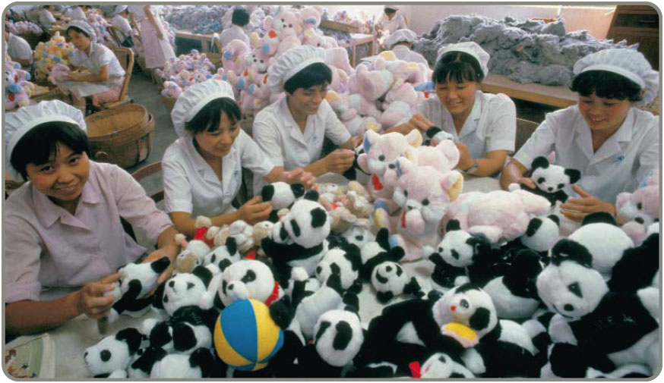
Disadvantages of Outsourcing
Increased transportation costs
Loss of control
Creating future competition
Negative impact on employees
Longer-term
impact

Slide 75
Audits and Metrics
Outsourcing agreements must specify results and outcomes
Evaluation necessary to ensure satisfactory performance
If the outsourced product or service is strategically important, the relationship needs continuing communication, understanding, trust and performance
Services may require imaginative metrics

Slide 76
Ethical Issues in Outsourcing
Ethics Principle Outsourcing Linkage
Do no harm to indigenous cultures | Avoid outsourcing in a way that violates religious holidays
Do no harm to the ecological systems | Don’t use outsourcing to move pollution from one country to another
Uphold universal labor standards | Don’t use outsourcing to take advantage of cheap child labor that leads to employee abuse
Notes:
Students should understand both the concepts of natural and assignable variation, and the nature of the efforts required to deal with them.

Slide 77
Ethical Issues in Outsourcing
Ethics Principle Outsourcing Linkage
Uphold basic human rights | Don’t accept outsourcing that violates basic human rights
Pursue long-term involvement | Don’t use outsourcing as a short-term arrangement to reduce costs; view it as a long-term partnership
Share knowledge and technology | Don’t think an outsourcing agreement will prevent loss of technology, but use the inevitable sharing to build a good relationship with outsourcing firms
Notes:
Students should understand both the concepts of natural and assignable variation, and the nature of the efforts required to deal with them.

Slide 78
Regents Park Publishers
Operations Management
T3LM3
End

