Slide 1
Regents Park Publishers
Operations Management
T1LM1
Key
Frameworks

Slide 2
1. Managing for the Future

Slide 3
The Challenge

Slide 4
The Challenge
Video - Did you know?
What does all of this mean for you?

Slide 5
1. Organizations have to be managed for the future not for the past. 2. The exact future cannot be predicted with any degree of certainty. 3. What managers can do is to predict the range of possible outcomes. Then choose the one that has the greatest probability of success.
Key Points

Slide 6
The Path

Slide 7
The Path
The ultimate managerial challenge:
which path will you put your company on?
Future
Path
Maximum Desirable Outcome
Range of Potential Outcomes
Historical Path
Performance
Maximum Undesirable Outcome
Today
Time

Slide 8
The Tools

Slide 9
The Tools
Managers have to use the proper analytical tools to make value creating decisions.
Forensic Tools
(Time series, GAP)
Predictive Tools
(associations, inference, analogs)
Maximum
Desirable Outcome
Future
Path
Range of Potential Outcomes
Historical Path
Performance
Maximum Undesirable Outcome
Today
Time

Slide 10
Risk and Utility

Slide 11
1. Individuals have their own preference for taking risks. 2. This preference will vary with the size of the gamble. 3. Risk takers: will get more utility (thrill) with large gambles. 4. Risk avoiders: get more utility from avoiding risks. 5. Risk neutral persons derive the same level of utility regardless of the size of the gamble. 6. Management must know the risk profile of each employee and match their risk profiles with their job responsibilities.
Risk and Utility

Slide 12
Regression to the Mean

Slide 13
Regression to the Mean
Returns
Your Firm’s Returns
Regression to the Mean Process
Mean Returns
Absolute Competitive Advantage Period
Protect your organization from being commoditized.
Time

Slide 14
Link: www.morningstar.com
Morningstar
The concept of the economic moat.
It is utilized by Morningstar to assess companies with regards to their investment potential.
A wide moat, for example, represent a long competitive advantage period.

Slide 15
Crossing the “Chasm”

Slide 16
1. “The Chasm” is the challenge of scaling. 2. The processes of customer acquisition and operational support have to be aligned. 3. If that alignment is absent the firm will fold. 4. Approximately 95% of organizations cannot make the transition from selling to early adopters to selling to early majority. 5. This transition requires a movement from a stand alone operations to “ business eco-system” operations.
Key Points

Slide 17
Crossing the Chasm
Chasm
Consumers
Early
Majority
Late
Majority
Laggards
Early
Adopters
Specialty nichers
Time
Incomplete Perspective
Based on the concept developed by Geoffrey Moore.

Slide 18
Crossing the Chasm
Product Management
Price Management
Positioning
Marketing Domain
Consumers
Chasm
Early
Majority
Late
Majority
Laggards
Early
Adopters
Specialty nichers
Time
Capacity Planning
Product Rationalization
Cost Management
Distribution and Logistics
Supply Chain
Complete Perspective
(The Marketing and Operations Domains working in unison)
Operations Domain

Slide 19
2. Systems Thinking

Slide 20
An organization is a system where individual parts are connected and depend on each other. An organization has to be managed as a system, and not as a collection of individual functional parts.
Key Points

Slide 21
Systems Framework
All decisions have to consider all of these building blocks.
Marketing Effectiveness
External Environment
Pre-established Criteria
Unique Business Model
Customer Satisfaction
Financial Performance
Shareholders Value
Internal Capabilities
Operational Excellence

Slide 22
1. An organization is a system where individual parts are connected and depend on each other. 2. The alignment of the functional building blocks is a must. 3. An organization has to be managed as a system, and not as a collection of individual functional parts.
Key Points

Slide 23
1. To be successful, an organization has to have the right level of the required resources, at the right time, at the right place. 2. The following organizational flows will have to be aligned across the organization and with each other: * information * labor and skill * material * funds 3. This is the domain of Operations Management
Key Points

Slide 24
Systems Thinking
Underlying givens of the systems thinking approach:
Functions: connected not separate
Operating processes: continuous not discrete
Decisions: fact not opinion based
Management: purposeful not at-hock
Planning and implementation: aligned
Outcomes: anticipated not random
Business model: adaptable not rigid
Feedback: continuous improvement focused

Slide 25
Simulation of Operations

Slide 26
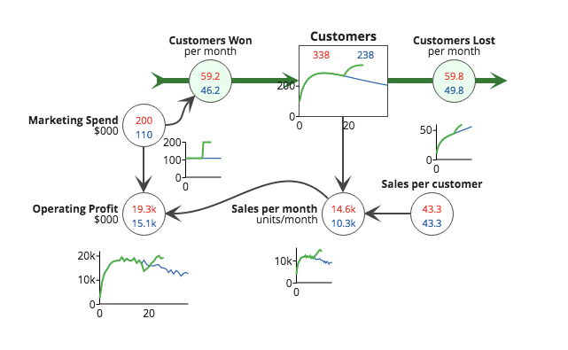
Simulation of Operations
Kim Warren Strategy Dynamics

Slide 27
Systems Thinking
Optional Reading
Systems thinking is superior to a Function-centric thinking….

Slide 28
3. Systems Reliability

Slide 29
1. The quality of decisions has to be built-in not tested- out. 2. The principles of the TQM as related to sequential production system do not do not apply to the parallel, systems based organizational design.
Key Points

Slide 30
Systems Reliability
Sr. Mgmt.
Mktg.
Eng.
Mfg.
Sales
.9
.9
.9
.9
.9
Functional silos performance (%)
What grade would you give this organization?

Slide 31
Systems Reliability
Sr. Mgmt
Mktg.
Eng.
Mfg.
Sales
.90
.90
.90
.90
.90
x
x
x
x
= .59 of the potential
Quality of decisions has to be built into the managerial process, not tested out.

Slide 32
4. Decision Making Imperative

Slide 33
1. Consistency and reliability in managerial decision making is the key prerequisite for success. 2. Bad decisions propagate and destroy value. 3. There are three key decision making environments: certainty, risk, and uncertainty. 4. Individual propensity to take a risk and the individual utility will effect how decisions are made. 5. The key managerial challenge is the alignment of the decisions made on the individual level with the overall objectives of the firm.
Key Points

Slide 34
5. Absolute Competitive Advantage

Slide 35
To win in the marketplace, an organization has to have the Absolute Competitive Advantage (ACA) vis-a-vis its peers.
Key Points

Slide 36
ACA Building Blocs
Positioning
(Marketing Domain)
Attributes
Accessibility
Affordability
Product Domain
Operating
Domain
Availability
Aesthetics
Appeal
Absolute Competitive Advantage

Slide 37
Factors of Attention
Potential customers (prospects) have to :
Recognize the Relevance of your of your offer
Believe your Promise
Perceive you as the owner of the Word
Have a positive Resonance to your message
Have the potential to create a critical mass and network effect.
Be a part of the “Conviction chain”.

Slide 38
Factors of Accessibility
Your products or service has to be accessible to your customers. That means that your products have to be placed at the points of distribution where your customers shop.
Your selection of the points of distribution should be a composite of:
Retail locations
Distance required by customers to travel to these locations
Saturation of the area by competitive outlets
Logistics of the supply chain

Slide 39
Factors of Availability
When a customer is at the point of sale, your product or service has to be available and ready to be sold. Otherwise, the potential customer may switch to a competitive option. In order to ascertain that availability, the following operational tasks have to be aligned:
Product inventory management
Demand forecasting
Logistics and transportation
Supply chain capacity management
Balancing demand with supply through pricing or allocation mechanisms
Slotting fees payments for access to the shelf space

Slide 40
Factors of Appeal
Appeal is the intangible perception of value based on the:
Features of a physical design
User friendly interface
Attractive packaging
Newness of the product
Elements of service
Brand appeal

Slide 41
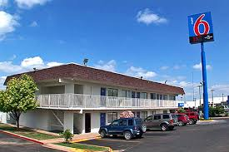
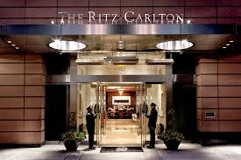
Factors of Aesthetics
Confirming Servicescape- the appearance of facilities should match the brand positioning.
Both sets of customers will be equally satisfied with the stay at the lodging shown below providing that their expectations are met.

Slide 42
Factors of Affordability
Customers perception of value has to match the price point at the point of sale. The following elements have to be aligned:
Retail Price Point with the willingness to pay
Cost Points along the upstream value chain
Cost points along the downstream value chain
Learning Curves and experience curve effects

Slide 43
Factors of Attributes
The attributes of a product of service have to deliver the benefits sought by a customer. The following elements have to aligned:
Applicability: degree of provided benefits
Ingredient: unique differentiating ingredient
Quality: level of quality expected by a customer
Service: expected level of component of service
Sustainability: level of positive and negative externalities created during and after the use.

Slide 44
Alignment
Promise
Attention
Attributes
Accessibility
Alignment
Product
Affordability
Availability
Delivery
Aesthetics
Appeal
Outcome

Slide 45
6. Moment of Truth

Slide 46
Key Points
All firms compete for a customer choice.
The choice is made at the moment of truth.
The choice is made based on the brand promise.
The brand promises a certain customer experience and customers have that expectation at the moment of truth.
Responsibility of Operations Management is to deliver that promise.
If there is a gap between the expected and the actual experience the remedy has to be applied to close any gaps that may exits

Slide 47
The Moment of Truth
Remedy is needed when the actual experience differs from the expected experience.
Brand
Promise
Customer Expectations
Gaps
Remedy
Marketing creates a brand promise.
Operations must deliver on that promise.
Moment of Truth
Actual Experience
Operations Management
All efforts are wasted when a customer does not choose your product at the moment of truth”.

Slide 48
7.Creativity and Lateral Thinking

Slide 49
Creativity and Lateral Thinking
Dr. Edvard De Bono
“Blue Ocean” Strategy

Slide 50
Regents Park Publishers
T1LM1
End

