Slide 1
Business Analytics
T3LM2
Two Population Variances
F – Test

Slide 2
Hypothesis Tests for Variances
Hypothesis Tests
for Variances
Tests for a Single
Population Variances
Tests for Two
Population Variances
Chi-Square test statistic
F test statistic

Slide 3
F Test for Difference in Two Population Variances
Hypothesis Tests for Variances
*
Tests for Two
Population Variances
H₀: σ₁² – σ₂² = 0
H_{A}: σ₁² – σ₂² ≠ 0
Two tailed test
H₀: σ₁² – σ₂² ≥ 0
H_{A}: σ₁² – σ₂² < 0
Lower tail test
F test statistic
H₀: σ₁² – σ₂² ≤ 0
H_{A}: σ₁² – σ₂² > 0
Upper tail test

Slide 4
Finding the Critical Value
H₀: σ₁² – σ₂² ≥ 0
H_{A}: σ₁² – σ₂² < 0
H₀: σ₁² – σ₂² = 0
H_{A}: σ₁² – σ₂² ≠ 0
H₀: σ₁² – σ₂² ≤ 0
H_{A}: σ₁² – σ₂² > 0
α
Do not
reject H₀
α/2
0
F
0
F
Do not
reject H₀
F_{α critical}
F_{α/2 critical}
F_{α/2 critical}
Reject H₀
Reject H₀

Slide 5
Finding the Critical Value
H₀: σ₁² – σ₂² ≥ 0
H_{A}: σ₁² – σ₂² < 0
H₀: σ₁² – σ₂² = 0
H_{A}: σ₁² – σ₂² ≠ 0
H₀: σ₁² – σ₂² ≤ 0
H_{A}: σ₁² – σ₂² > 0
α
Do not
reject H₀
α/2
0
F
0
F
Do not
reject H₀
F_{α critical}
F_{α/2 critical}
F_{α/2 critical}
Reject H₀
Reject H₀

Slide 6
F Test for Difference in Two Population Variances
Hypothesis Tests for Variances
The F test statistic is:
Tests for Two
Population Variances
(Place the larger sample variance in the numerator)
Test
*
F test statistic
= Variance of Sample 1
n₁ - 1 = numerator degrees of freedom
= Variance of Sample 2
n₂ - 1 = denominator degrees of freedom

Slide 7
Business Rule
H₀: σ₁² – σ₂² ≥ 0
H_{A}: σ₁² – σ₂² < 0
H₀: σ₁² – σ₂² = 0
H_{A}: σ₁² – σ₂² ≠ 0
H₀: σ₁² – σ₂² ≤ 0
H_{A}: σ₁² – σ₂² > 0
α
Do not
reject H₀
α/2
0
F
0
F
Do not
reject H₀
F_{α critical}
F_{α/2 critical}
F_{α/2 critical}
Reject H₀
Reject H₀
The Ho rejection region for a one-tail test is:
The Ho rejection region for a two-tailed test is:
Test
Critical
Test
Critical
(when the larger sample variance in the numerator)

Slide 8
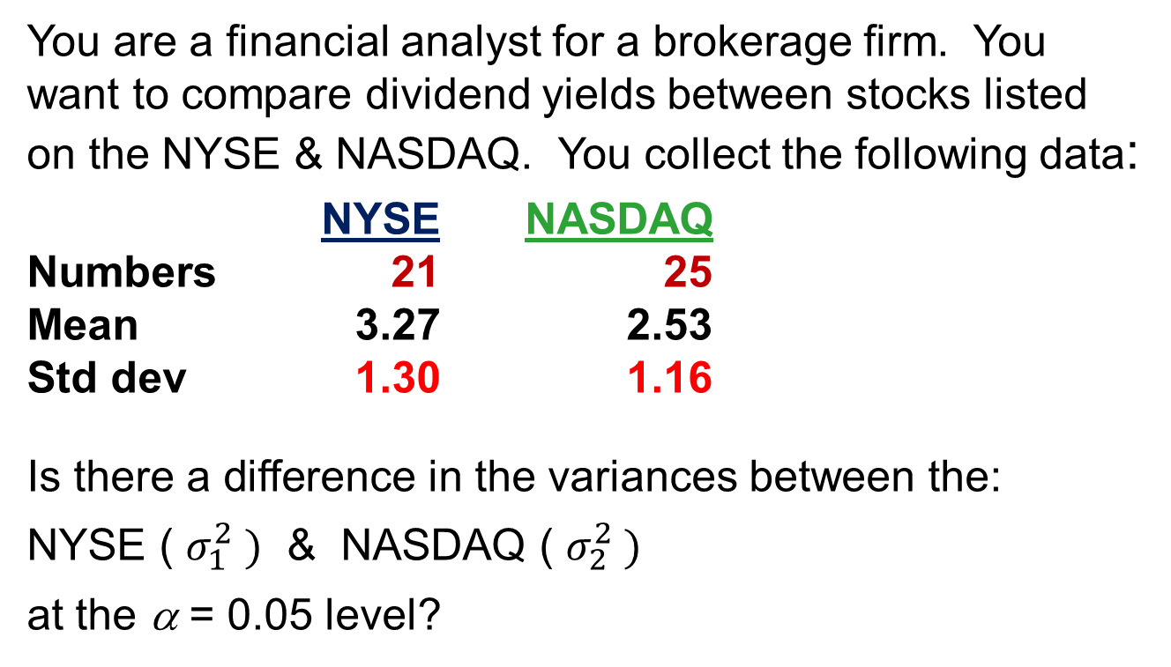
F Test: An Example
You are a financial analyst for a brokerage firm. You want to compare dividend yields between stocks listed on the NYSE & NASDAQ. You collect the following data:
NYSE NASDAQ
Numbers 21 25
Mean 3.27 2.53
Std dev 1.30 1.16
Is there a difference in the variances between the:
NYSE ( $σ_{1}^{2} )$ & NASDAQ ( $σ_{2}^{2} )$
at the α = 0.05 level?

Slide 9
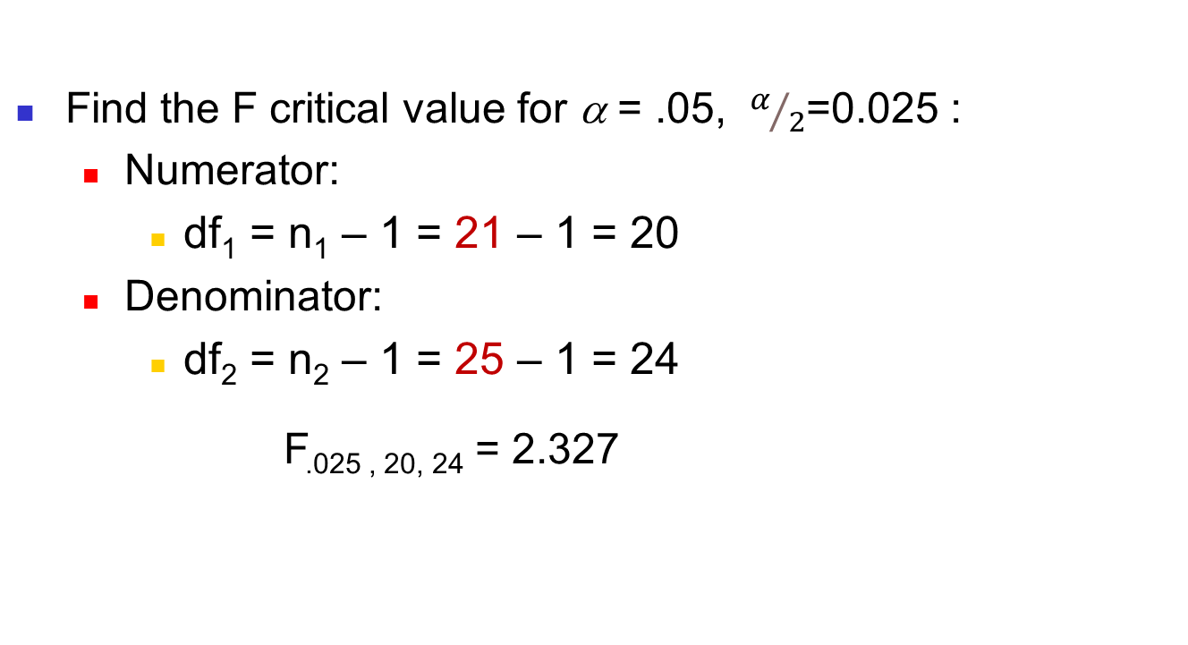
F Test: Example Solution
Form the hypothesis test:
  H₀: σ²₁ – σ²₂ = 0 (there is no difference between variances)
  H_{A}: σ²₁ – σ²₂ ≠ 0 (there is a difference between variances)
Find the F critical value for α = .05, $α/2$=0.025 :
  Numerator:
    df₁ = n₁ – 1 = 21 – 1 = 20
  Denominator:
    df₂ = n₂ – 1 = 25 – 1 = 24
  F_{.025 , 20, 24} = 2.327
Excel: Formulas to More Functions to Statistical to
F.INV.RT(0.025,20,24)

Slide 10
F Test: Example Solution
(continued)
The test statistic is:
H₀: σ₁² – σ₂² = 0
H_{A}: σ₁² – σ₂² ≠ 0
Test
α/2 = .025
0
F = 1.256 is not greater than the critical F value of 2.327, so we do not reject H₀
Do not
reject H₀
Reject H₀
Test
F_{α/2} =2.327
Conclusion: There is no evidence of a difference in variances at α = .05

Slide 11
Using EXCEL
EXCEL: F test for two variances (if data arrays are given):
Data to Data Analysis to F-test: two sample for variances
or
  Calculate the values of s1 and s2, and use the previous formula used in this example.

Slide 12
Business Analytics
T3LM2
End

