Slide 1
T1LM1
v.2
The Role of Reasoning in Business

Slide 2
Key Axioms
Management of the Future
Business is a System
Decision Environments Vary
Decision makers are Biased
The impact of Randomness and Chance cannot be ignored
There will never be one “Correct” answer
Ethical choices will create value in the long run.
Competition for and Psychology of Choice.

Slide 3
Until the AI is fully operational individuals make decisions. Every Decision Maker is Biased !!! The errors in judgement will propagate and magnify in a system. Randomness and Chance will always be present.
Decision Making Responsibility

Slide 4
Managing for the Future

Slide 5
The Challenge
Video - Did you know?
What does all of this mean for you?

Slide 6
1. Organizations must be managed for the future not for the past. 2. The exact future cannot be predicted with any degree of certainty. 3. What managers can do is to predict the range of possible outcomes. Then choose the one that has the greatest probability of success.
Key Points

Slide 7
The Path

Slide 8
The Path
The ultimate managerial challenge:
which path will you put your company on?
Future
Path
Maximum Desirable Outcome
Historical Path
Range of Potential Outcomes
Performance
Maximum Undesirable Outcome
Today
Time

Slide 9
The Tools

Slide 10
The Tools
Managers have to use the proper analytical tools to make value creating decisions.
Forensic Tools
(Time series, GAP)
Predictive Tools
(associations, inference, analogs)
Maximum
Desirable Outcome
Future
Path
Range of Potential Outcomes
Historical Path
Performance
Maximum Undesirable Outcome
Today
Time

Slide 11
Business is a System

Slide 12
An organization is a system where individual parts are connected and depend on each other. An organization must be managed as a system, and not as a collection of individual functional parts.
Key Points

Slide 13
Systems Thinking
Underlying givens of the systems thinking approach:
Functions: connected not separate
Operating processes: continuous not discrete
Decisions: fact not opinion based
Management: purposeful not at-hock
Planning and implementation: aligned
Outcomes: anticipated not random
Business model: adaptable not rigid
Feedback: continuous improvement focused

Slide 14
Systems Framework
All decisions have to consider all these building blocks.
Marketing Effectiveness
External Environment
Pre-established Criteria
Unique Business Model
Customer Satisfaction
Financial Performance
Shareholders Value
Internal Capabilities
Operational Excellence

Slide 15
The Challenge

Slide 16
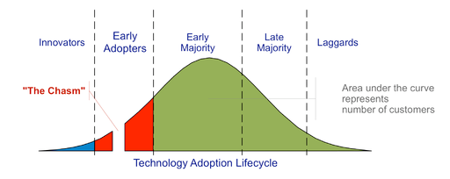
Crossing the Chasm
Operations Management

Slide 17
1. An organization is a system where individual parts are connected and depend on each other. 2. The alignment of the functional building blocks is a must. 3. An organization has to be managed as a system, and not as a collection of individual functional parts.
Key Points

Slide 18
1. To be successful, an organization must have the right level of the required resources, at the right time, at the right place. 2. The following organizational flows will have to be aligned across the organization and with each other: * information * labor and skill * material * funds 3. Accurate forecasting is difficult if impossible.
Key Points

Slide 19
Simulation of Operations

Slide 20
Simulation of Operations
Kim Warren Strategy Dynamics

Slide 21
Systems Reliability

Slide 22
1. The quality of decisions has to be built-in not tested- out. 2. The principles of the TQM as related to sequential production system do not do not apply to the parallel, systems based organizational design.
Key Points

Slide 23
Systems Reliability
Sr. Mgmt.
Mktg.
Eng.
Mfg.
Sales
.9
.9
.9
.9
.9
Functional silos performance (%)
What grade would you give this organization?

Slide 24
Systems Reliability
Sr. Mgmt
Mktg.
Eng.
Mfg.
Sales
.90
.90
.90
.90
.90
x
x
x
x
= .59 of the potential
Quality of decisions has to be built into the managerial process, not tested out.

Slide 25
1. Consistency and reliability in managerial decision making is the key prerequisite for success. 2. Bad decisions propagate and destroy value. 3. There are three key decision-making environments: certainty, risk, and uncertainty. 4. Individual propensity to take a risk and the individual utility will impact how decisions are made. 5. The key managerial challenge is the alignment of the decisions made on the individual level with the overall objectives of the firm.
Key Points

Slide 26
Decision Environments

Slide 27
1. Individuals have their own preference for taking risks. 2. This preference will vary with the size of the gamble. 3. Risk takers: will get more utility (thrill) with large gambles. 4. Risk avoiders: get more utility from avoiding risks. 5. Risk neutral persons derive the same level of utility regardless of the size of the gamble. 6. Management must know the risk profile of each employee and match their risk profiles with their job responsibilities. 7. Bias is built-in any decision making because the “self” factor. 8. Variations can have assignable causes and unassignable causes.
Risk , Utility, and Bias

Slide 28
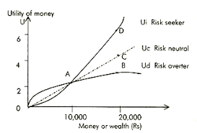
1. Certainty 2. Known Risk 3. Uncertainty
Decision Making Environments

Slide 29
Bias

Slide 30
The Mindshare
1. The thoughts lead to words
2. The words lead to actions
3. The actions lead to habits
4. The habits lead to character
5. The character leads to destiny

Slide 31
Sources of Bias
Attributed to “know-how”
Attributed to “Self”
Data Collection
Process
Data Analysis Methodology
Knowledge
Gained
Interpretation
of Findings
Decision and Action Taken
During each step of the analytics process an additional bias is introduced. This reduces the reliability of the entire sequence.

Slide 32
The Hidden Traps of Decision Making
1. The Anchoring Trap
2. The Status-Quo Trap
3. The Sunk- Cost Trap
4. The Confirming Evidence Trap
5. The Framing Trap
6. Estimating and Forecasting Trap
7. The Prudence Trap
8. The Recallability Trap
HBR article

Slide 33
Randomness and Chance

Slide 34
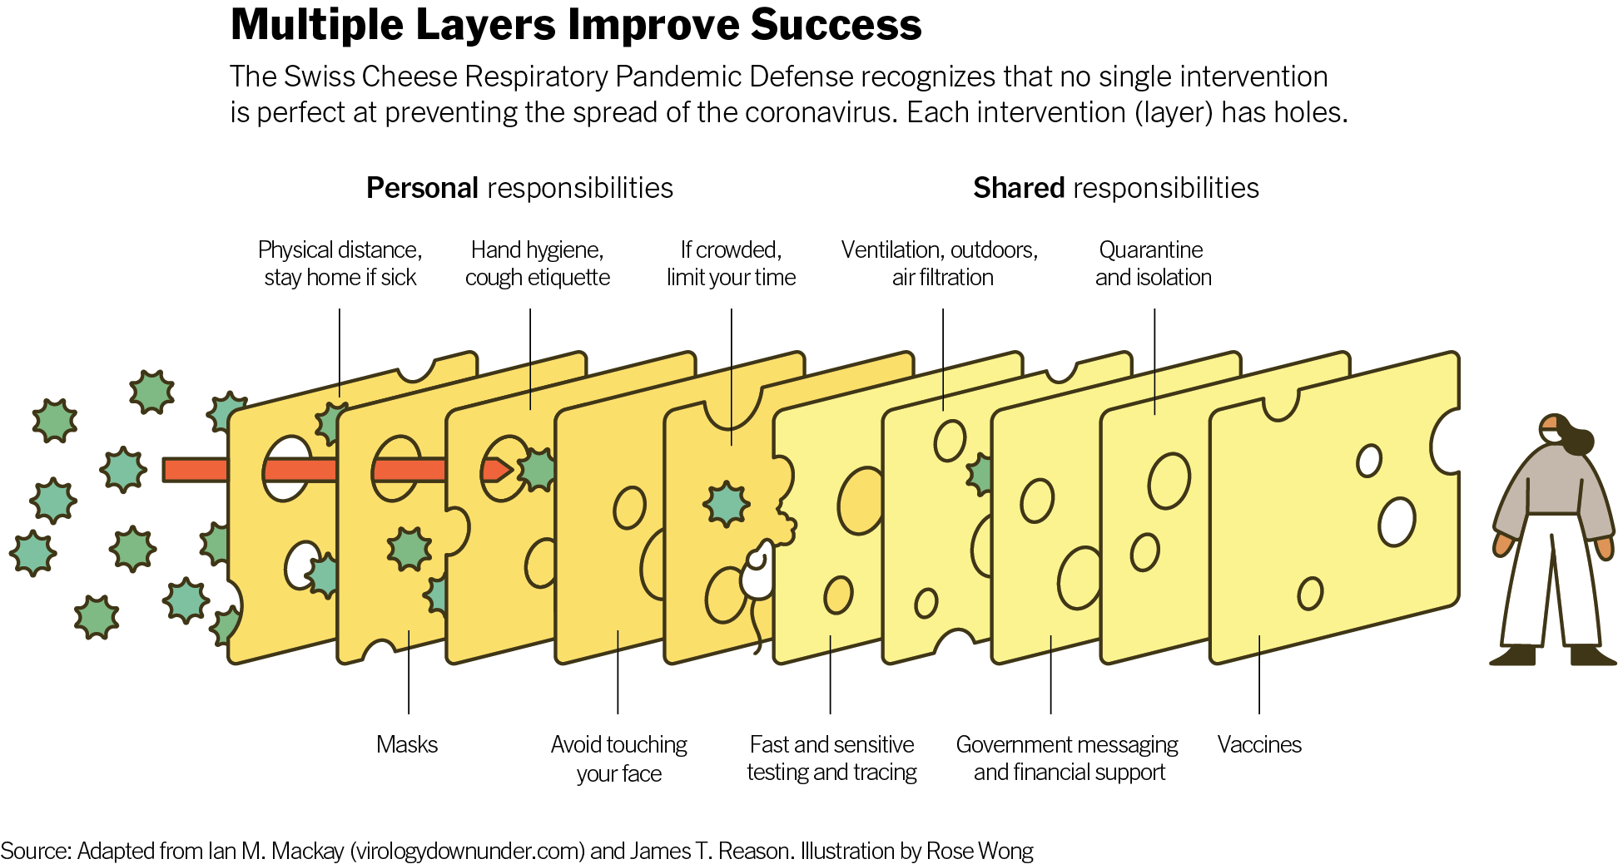
“Swiss Cheese” Method

Slide 35
Covid-19 Example
Assumption: Two individuals not wearing masks. One is infected.
No Mask (1)
No Mask (1)
Probability of Infection of the healthy one = 100%*100% = 100%
Assumptions: Only one individual is wearing a mask.
Mask effectiveness = 70% of preventing droplets to spread. One is infected.
Mask (0.3)
No Mask (1)
Probability of infection of the healthy one = 30%*100% = 30%
Assumptions: Both individuals are wearing masks.
Mask effectiveness = 70%. One is infected.
Mask (0.3)
Mask (0.3)
Probability of infection of the healthy one = 30% * 30% = 9%

Slide 36
Ethics

Slide 37
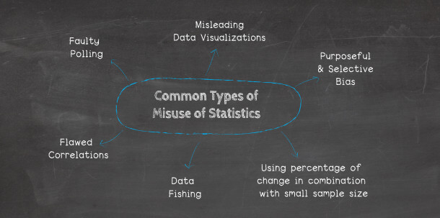
Ethics and Statistics

Slide 38
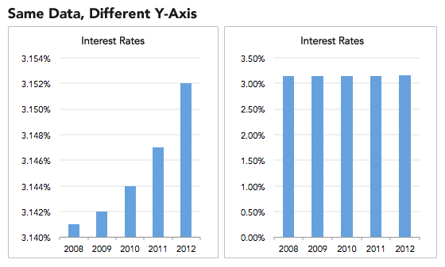
Ethics and Statistics

Slide 39
Ethics and Statistics

Slide 40
Ethics and Statistics

Slide 41
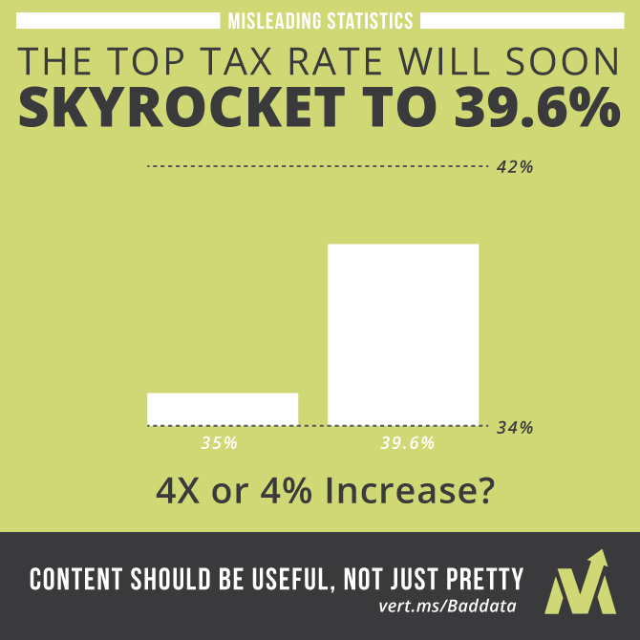
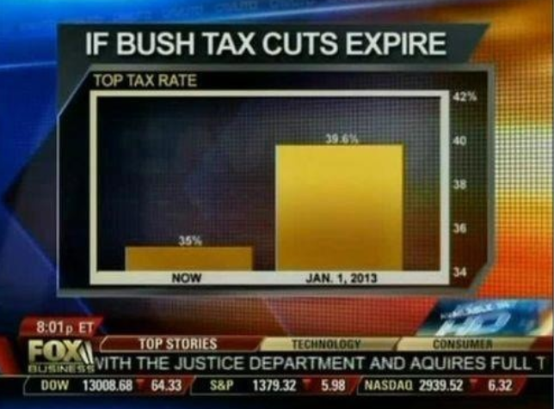
Ethics and Statistics

Slide 42
Ethics and Statistics
During each step of the analytics process an additional bias is introduced. This reduces the reliability of the entire sequence.

Slide 43
Psychology of Choice

Slide 44
Key Points
All firms compete for a customer choice.
The choice is made at the moment of truth.
The choice is made based on the brand promise.
The brand promises a certain customer experience and customers have that expectation at the moment of truth.
Responsibility of Operations Management is to deliver that promise.
If there is a gap between the expected and the actual experience the remedy has to be applied to close any gaps that may exits

Slide 45
The Moment of Truth
Remedy is needed when the actual experience differs from the expected experience.
Brand
Promise
Customer Expectations
Gaps
Remedy
Marketing creates a brand promise.
Operations must deliver on that promise.
Moment of Truth
Actual Experience
Operations Management
All efforts are wasted when a customer does not choose your product at the moment of truth”.

Slide 46
Key Points
“Shooting from the hip” is just that
Fake news are just that- “fake”
Lies and misinformation destroy value
Disciplined is the key to manage the flow of:
Volume
Variety
Veracity
Velocity
of data

Slide 47
Congruity
When there's congruity, things fit together in a way that makes sense. If a team has congruity, the players work together well, even if they don’t win.

Slide 48
T1LM1
End

