Slide 1

Regents Park Publishers
BUS 324
T3LM1
Linear Regression & Correlation

Slide 2
Module Goals
After completing this Module, you should be able to:
Calculate and interpret the simple correlation between two variables
Determine whether the correlation is significant
Calculate and interpret the simple linear regression equation for a set of data
Understand the assumptions behind regression analysis
Determine whether a regression model is significant

Slide 3
Correlation

Slide 4
Scatter Plots and Correlation
A scatter plot (or scatter diagram) is used to show the relationship between two variables
Correlation analysis is used to measure strength of the association (linear relationship) between two variables
  Only concerned with strength of the relationship
  No causal effect is implied

Slide 5
Scatter Plot Examples
Linear relationships
Curvilinear relationships
y
y
x
x
y
y
x
x

Slide 6
Scatter Plot Examples
(continued)
Strong relationships
Weak relationships
y
y
x
x
y
y
x
x

Slide 7
Scatter Plot Examples
(continued)
No relationship
y
x
y
x

Slide 8
Correlation Coefficient
(continued)
The population correlation coefficient ρ (rho) measures the strength of the association between the variables
The sample correlation coefficient r is an estimate of ρ and is used to measure the strength of the linear relationship in the sample observations

Slide 9
Features of ρ and r
Unit free
Range between -1 and 1
The closer to -1, the stronger the negative linear relationship
The closer to 1, the stronger the positive linear relationship
The closer to 0, the weaker the linear relationship

Slide 10
Examples of Approximate r Values
y
y
y
x
x
x
r = -1
r = -.6
r = 0
y
y
x
x
r = +.3
r = +1

Slide 11
Calculating the
Correlation Coefficient
Sample correlation coefficient:
or the algebraic equivalent:
where:
r = Sample correlation coefficient
n = Sample size
x = Value of the independent variable
y = Value of the dependent variable

Slide 12
Calculation Example
Tree Height | Trunk Diameter
y | x
35 | 8
49 | 9
27 | 7
33 | 6
60 | 13
21 | 7
45 | 11
51 | 12

Slide 13
Excel Output
Excel Correlation Output 1
Data analysis / correlation…
Correlation between
Tree Height and Trunk Diameter

Slide 14
Correlation using Regression
Excel Correlation Output 2
Data analysis / Regression…
SUMMARY OUTPUT
Regression Statistics
Multiple R | 0.886231
R Square | 0.785406
Adjusted R Square | 0.74964
Standard Error | 6.634991
Observations | 8
ANOVA
 | df | SS | MS | F | Significance F
Regression | 1 | 966.7363 | 966.7363 | 21.95975 | 0.003374
Residual | 6 | 264.1387 | 44.02311
Total | 7 | 1230.875
 | Coefficients | Standard Error | t Stat | P-value | Lower 95% | Upper 95% | Lower 95.0% | Upper 95.0%
Intercept | -1.31467 | 9.148913 | -0.1437 | 0.890445 | -23.7013 | 21.07192 | -23.7013 | 21.07192
X Variable 1 | 4.541333 | 0.969103 | 4.686123 | 0.003374 | 2.170025 | 6.912642 | 2.170025 | 6.912642
Multiple R = Correlation Coefficient

Slide 15
Calculation Example
(continued)
Tree
Height,
y
r = 0.886 → relatively strong positive
linear association between x and y
Trunk Diameter, x

Slide 16
Simple Linear Regression Model

Slide 17
Introduction to Regression Analysis
Regression analysis is used to:
  Predict the value of a dependent variable based on the value of at least one independent variable
  Explain the impact of changes in an independent variable on the dependent variable
Dependent variable: the variable we wish to explain
Independent variable: the variable used to explain the dependent variable

Slide 18
Simple Linear Regression Model
Only one independent variable, x
Relationship between x and y is described by a linear function
Changes in y are assumed to be caused by changes in x

Slide 19
Population Linear Regression
The population regression model:
Population Slope
Coefficient
Random Error term, or residual
Population
y intercept
Independent Variable
Dependent Variable
Linear component
Random Error
component

Slide 20
Population Linear Regression
(continued)
y
Observed Value of y for x_{i}
ε_{i}
Slope = β₁
Predicted Value of y for x_{i}
Random Error for this x value
Intercept = β₀
x_{i}
x

Slide 21
Estimated Regression Model
The sample regression line provides an estimate of the population regression line
Estimated (or predicted) y value
Estimate of the regression
intercept
Estimate of the regression slope
Independent variable
The individual random error terms e_{i} have a mean of zero

Slide 22
Finding the Least Squares Equation
The coefficients b₀ and b₁ will usually be found using computer software, such as Excel
Other regression measures will also be computed as part of computer-based regression analysis

Slide 23
Simple Linear Regression
Example 1

Slide 24

Simple Linear Regression Example
A real estate agent wishes to examine the relationship between the selling price of a home and its size (measured in square feet)
A random sample of 10 houses is selected
  Dependent variable (y) = house price in $1000s
  Independent variable (x) = square feet

Slide 25
Example: House Prices
House Price in $1000s (y) | Square Feet (x)
245 | 1400
312 | 1600
279 | 1700
308 | 1875
199 | 1100
219 | 1550
405 | 2350
324 | 2450
319 | 1425
255 | 1700
Predict the price for a house with 2,000 square feet

Slide 26
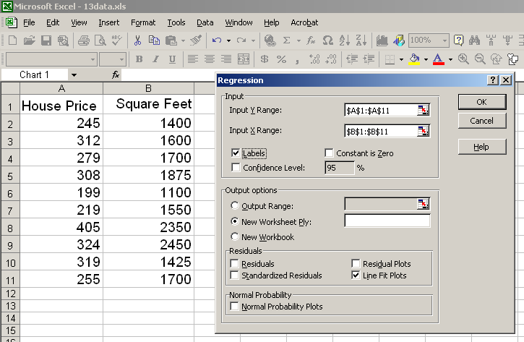
Regression Using Excel
Data Analysis / Regression

Slide 27
Excel Output
Regression Statistics
Multiple R | 0.76211
R Square | 0.58082
Adjusted R Square | 0.52842
Standard Error | 41.33032
Observations | 10
ANOVA | df | SS | MS | F | Significance F
Regression | 1 | 18934.9348 | 18934.9348 | 11.0848 | 0.01039
Residual | 8 | 13665.5652 | 1708.1957
Total | 9 | 32600.5000
 | Coefficients | Standard Error | t Stat | P-value | Lower 95% | Upper 95%
Intercept | 98.24833 | 58.03348 | 1.69296 | 0.12892 | -35.57720 | 232.07386
Square Feet | 0.10977 | 0.03297 | 3.32938 | 0.01039 | 0.03374 | 0.18580
The regression equation is:

Slide 28
Example: House Prices
(continued)
Predict the price for a house with 2000 square feet:
The predicted price for a house with 2000 square feet is 317.85($1,000s) = $317,850

Slide 29
Coefficient of Determination

Slide 30
Coefficient of Determination, R²
The coefficient of determination is the portion of the total variation in the dependent variable that is explained by variation in the independent variable.
Translation: Shows how good your model is
The coefficient of determination is also called R-squared and is denoted as R^{2.}
R-squared values fall between 0 and 1

Slide 31
Excel Output
Regression Statistics
Multiple R | 0.76211
R Square | 0.58082
Adjusted R Square | 0.52842
Standard Error | 41.33032
Observations | 10
ANOVA | df | SS | MS | F | Significance F
Regression | 1 | 18934.9348 | 18934.9348 | 11.0848 | 0.01039
Residual | 8 | 13665.5652 | 1708.1957
Total | 9 | 32600.5000
 | Coefficients | Standard Error | t Stat | P-value | Lower 95% | Upper 95%
Intercept | 98.24833 | 58.03348 | 1.69296 | 0.12892 | -35.57720 | 232.07386
Square Feet | 0.10977 | 0.03297 | 3.32938 | 0.01039 | 0.03374 | 0.18580
58.08% of the variation in house prices is explained by variation in square feet

Slide 32
Module Summary
Introduced correlation analysis
Discussed correlation to measure the strength of a linear association
Introduced simple linear regression analysis
Calculated the coefficients for the simple linear regression equation
Addressed assumptions of regression and correlation

Slide 33
Regents Park Publishers
T3LM1
End

