Slide 1
Chapter 8 - Accounting: Decision Making by the Numbers

Slide 2
Learning Outcomes 1
Define accounting and describe how accounting information is used by a variety of stakeholders
Identify the purposes and goals of generally accepted accounting principles
Describe the key elements of the major financial statements

Slide 3
Learning Outcomes 2
Describe several methods stakeholders can use to obtain useful insights from a company’s financial statements
Explain how budget process can help managers plan, motivate, and evaluate their organization’s performance
Explain the role of managerial accounting and describe the various cost concepts identified by managerial accountants

Slide 4
Accounting
LO 1
System for recognizing, organizing, analyzing, and reporting information about the financial transactions that affect an organization
Goal
To provide users with relevant, timely information that can help them make better economic decisions

Slide 5
Users of Accounting Information
LO 1
Managers
Stockholders
Employees
Creditors
Suppliers
Government agencies
News media
Competitors
Unions

Slide 6
Roles of Accountants
LO 1
Public accountants
Provide services such as tax preparation, external auditing, and management consulting to clients on a fee basis
Management accountants
Work within a company and provide analysis, prepare reports and financial statements, and assist managers
Government accountants
Perform accounting functions for local, state, or federal government agencies

Slide 7
Financial Accounting
LO 2
Branch of accounting that prepares financial statements for use by owners, creditors, suppliers, and other external stakeholders
Stakeholders need this information to analyze the financial condition of the firm over a period of time
Generally accepted accounting principles (GAAP)
Set of accounting standards used in the preparation of financial statements

Slide 8
Financial Accounting Standards Board (FASB)
LO 2
Establishes the generally accepted accounting principles used in the practice of financial accounting
Aims to ensure that financial statements are:
Relevant
Reliable
Consistent
Comparable

Slide 9
Financial Statements - Balance Sheet
LO 3
Reports the financial position of a firm by identifying and reporting the value of the firm’s:
Assets: Resources owned by a firm
Liabilities: Claims that outsiders have against a firm’s assets
Owner’s equity: Claims that a firm’s owners have against their company’s assets
Reflects the accounting equation
Assets = Liabilities + Owner's Equity

Slide 10
Financial Statements - Income Statement
LO 3
Reports revenues, expenses, and net income that resulted from a firm’s operations over an accounting period
Revenue: Increases in assets that result from activities intended to earn income
Expenses: Resources that are used up as a result of business operations
Reflects the equation, Revenue − Expenses = Net income

Slide 11
Financial Statements - Statement of Cash Flows
LO 3
Identifies the amount of cash that flowed into and out of a firm through the following activities:
Cash flows from operating activities
Cash flows from investing activities
Cash flows from financing activities

Slide 12
Financial Statements - Other Statements
LO 3
Statement of retained earnings
Shows how retained earnings have changed from one accounting period to the next
Stockholders’ equity statement
Shows how net income and dividends affect retained earnings
Shows changes in stockholders’ equity, such as changes that arise from the issuance of additional shares of stock

Slide 13
Ways to Interpret Financial Statements
LO 4
Checking independent auditor’s report
Checking notes to financial statements
Looking for trends in comparative statements
Horizontal analysis: Compares account values reported on the financial statements over two or more years to identify changes and trends

Slide 14
Independent Auditor’s Report
LO 4
Prepared after conducting an annual external audit of the financial statements
Purpose - To verify if financial statements:
Are prepared in accordance with the generally accepted accounting principles
Fairly present the financial condition of the firm
Included in the annual report that a firm sends to its stockholders

Slide 15
Notes to Financial Statements
LO 4
Disclose additional information about a firm’s operations, accounting practices, and special conditions
Explain the specific accounting methods used to recognize revenue, value inventory, and depreciate fixed assets
Disclose changes in accounting methods or any risks that a firm may face

Slide 16
Budgeting
LO 5
Management tool that shows how a firm will acquire and allocate the resources needed to achieve its goals over a specific time period
Facilitates planning by requiring managers to:
Translate goals into measurable quantities
Identify the specific resources needed to achieve goals

Slide 17
Advantages of Budgeting
LO 5
Helps managers specify how they intend to achieve goals set during the planning process
Encourages communication and coordination among managers and employees
Serves as a motivational tool
Helps managers evaluate progress and performance

Slide 18
Top-Down Budgeting and Bottom-Up Budgeting
LO 5
Top-down budgeting
Top management prepares the budget with little or no input from middle and supervisory managers
Bottom-up (or participatory) budgeting
Middle and supervisory managers are allowed to participate actively in the creation of the budget

Slide 19
Types of Budgets
LO 5
Operating budgets
Communicate an organization’s sales and production goals and the resources needed to achieve them
Financial budgets
Focus on a firm’s financial goals and identify the resources needed to achieve them
Master budgets
Represent a firm’s overall plan of action for a specified time period

Slide 20
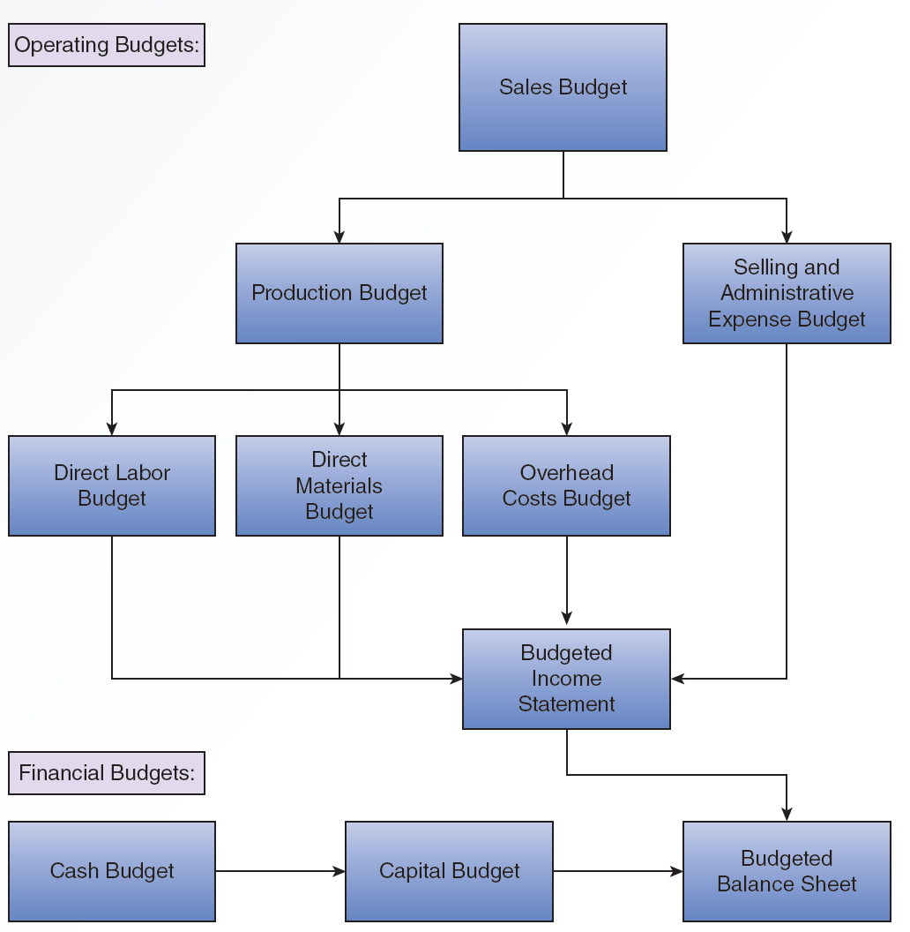
8.4 Development of the Master Budget
LO 5

Slide 21
Static Budget
LO 5
Based on a single assumed level of sales
Problem - Real-world sales vary considerably from the forecasted value
Figures become inaccurate
Can be avoided by preparing a flexible budget
Flexible budget - Developed over a range of possible sales levels and appropriate budgeted level of costs

Slide 22
8.5 Comparison of Financial and Managerial Accounting
LO 6
 | Financial accounting | Managerial accounting
Purpose | Primarily intended to provide information to external stakeholders, such as stockholders, creditors, and government regulators. Information provided is available to the general public. | Primarily intended to provide information to internal stakeholders, such as the managers of specific divisions or departments. This information is proprietary.
Type of information presented | Focuses almost exclusively on financial information. | Provides both financial and nonfinancial information.
Nature of reports | Prepares a standard set of financial statements. | Prepares customized reports to deal with specific problems or issues.

Slide 23
8.5 Comparison of Financial and Managerial Accounting (continued)
LO 6
 | Financial accounting | Managerial accounting
Timing of reports | Presents financial statements on a predetermined schedule (usually quarterly and annually). | Creates reports upon request by management rather than according to a predetermined schedule.
Adherence to accounting standards? | Governed by a set of generally accepted accounting principles (GAAP). | Uses procedures developed internally that are not required to follow GAAP.
Time period focus | Summarizes past performance and its impact on the firm’s present condition. | Provides reports dealing with past performance but also involves making projections about the future when dealing with planning issues.

Slide 24
Managerial Costs - Cost Concepts
LO 6
Out-of-pocket cost: Involves payment of money or other resources
Implicit cost: Arises when a firm uses owner-supplied resources
Fixed cost: Remains the same when the level of production changes within some relevant range
Variable cost: Varies directly with the level of production

Slide 25
Assigning Costs to Products
LO 6
Direct cost: Incurred directly as a result of some specific cost object
Indirect cost: Result of a firm’s general operations and is not directly tied to any specific cost object
Activity-based costing (ABC)
Technique to assign product costs based on links between activities that drive costs and the production of specific products

Slide 26
Key Terms
Accounting
Financial accounting
Generally accepted accounting principles (GAAP)
Financial Accounting Standards Board (FASB)
Balance sheet
Accounting equation
Assets
Liabilities
Owners’ equity
Income statement
Revenue
Accrual-basis accounting
Expenses
Net income

Slide 27
Key Terms 2
Statement of cash flows
Horizontal analysis
Budgeting
Operating budgets
Financial budgets
Master budget
Managerial (or management) accounting
Cost
Out-of-pocket cost
Implicit cost
Fixed costs
Variable costs
Direct cost
Indirect costs
Activity-based costing (ABC)

Slide 28
Summary
Accounting is a system for recognizing, organizing, analyzing, and reporting information that affects an organization
Key financial statements include balance sheet, income statement, and statement of cash flows
Budgeting helps understand how firms acquire and use resources
Managerial accounting provides reports and analysis to help make informed business decisions

Slide 29
Chapter 8 - Accounting: Decision Making by the Numbers

