Slide 1
Operations Management
Location Selection

Slide 2
Outline – Continued
Factors That Affect Location Decisions
Labor Productivity
Exchange Rates and Currency Risks
Costs
Political Risk, Values, and Culture
Proximity to Markets
Proximity to Suppliers
Proximity to Competitors (Clustering)

Slide 3
Outline – Continued
Methods of Evaluating Location Alternatives
The Factor-Rating Method
Locational Break-Even Analysis
Center-of-Gravity Method
Centroid Method
Transportation Model

Slide 4
Outline – Continued
Service Location Strategy
How Hotel Chains Select Sites
The Call Center Industry
Geographic Information Systems

Slide 5
Learning Objectives
When you complete this chapter you should be able to:
Identify and explain seven major factors that effect location decisions
Compute labor productivity
Apply the factor-rating method
Complete a locational break-even analysis graphically and mathematically

Slide 6
Learning Objectives
When you complete this chapter you should be able to:
Use the center-of-gravity method
Understand the differences between service and industrial-sector location strategies

Slide 7
Location Strategy
The objective of location strategy is to maximize the benefit of location to the firm

Slide 8
Location Strategy
One of the most important decisions a firm makes
Increasingly global in nature
Significant impact on fixed and variable costs
Decisions made relatively infrequently
The objective is to maximize the benefit of location to the firm

Slide 9
Location and Costs
Location decisions based on low cost require careful consideration
Once in place, location-related costs are fixed in place and difficult to reduce
Determining optimal facility location is a good investment

Slide 10
Location and Innovation
Cost is not always the most important aspect of a strategic decision
Four key attributes when strategy is based on innovation
High-quality and specialized inputs
An environment that encourages investment and local rivalry
A sophisticated local market
Local presence of related and supporting industries

Slide 11
Location Decisions
Long-term decisions
Decisions made infrequently
Decision greatly affects both fixed and variable costs
Once committed to a location, many resource and cost issues are difficult to change

Slide 12
Location Decisions
Country Decision
Key Success Factors
Political risks, government rules, attitudes, incentives
Cultural and economic issues
Location of markets
Labor talent, attitudes, productivity, costs
Availability of supplies, communications, energy
Exchange rates and currency risks

Slide 13
Location Decisions
Region/ Community Decision
Key Success Factors
Corporate desires
Attractiveness of region
Labor availability and costs
Costs and availability of utilities
Environmental regulations
Government incentives and fiscal policies
Proximity to raw materials and customers
Land/construction costs
MN
WI
MI
IL
IN
OH

Slide 14
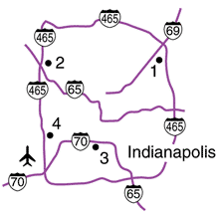
Location Decisions
Site Decision
Key Success Factors
Site size and cost
Air, rail, highway, and waterway systems
Zoning restrictions
Proximity of services/ supplies needed
Environmental impact issues

Slide 15
Global Competitiveness Index of Countries
Country Year 1 Rank Year 2 Rank
Switzerland 1 4
USA 2 1
Japan 8 10
Canada 9 13
UK 13 9
Israel 27 23
China 29 48
Italy 48 38
India 49 22
Mexico 60 59
Russia 63 53

Slide 16
Factors That Affect Location Decisions
Labor productivity
Wage rates are not the only cost
Lower productivity may increase total cost
Labor cost per day
Productivity (units per day)
= Cost per unit
Connecticut
Juarez
$70
60 units
$25
20 units
= $1.17 per unit
= $1.25 per unit

Slide 17
Factors That Affect Location Decisions
Exchange rates and currency risks
Can have a significant impact on costs
Rates change over time
Costs
Tangible - easily measured costs such as utilities, labor, materials, taxes
Intangible - less easy to quantify and include education, public transportation, community, quality-of-life

Slide 18
Factors That Affect Location Decisions
Exchange rates and currency risks
Can have a significant impact on cost structure
Rates change over time
Costs
Tangible - easily measured costs such as utilities, labor, materials, taxes
Intangible - less easy to quantify and include education, public transportation, community, quality-of-life

Slide 19
Factors That Affect Location Decisions
Political risk, values, and culture
National, state, local governments attitudes toward private and intellectual property, zoning, pollution, employment stability may be in flux
Worker attitudes towards turnover, unions, absenteeism
Globally cultures have different attitudes towards punctuality, legal, and ethical issues

Slide 20
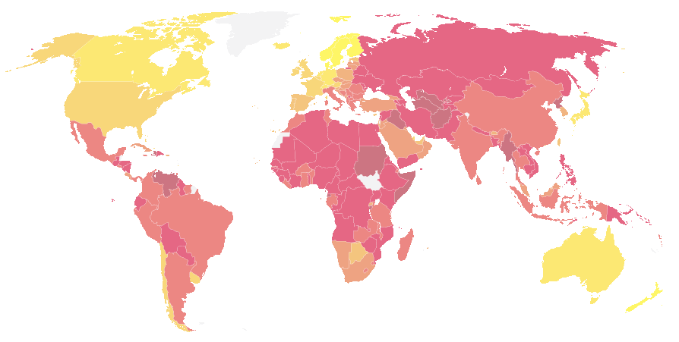
Ranking Corruption
Rank Country 2011 CPI Score (out of 10)
1 New Zealand 9.5
2 Demark, Finland 9.4
5 Singapore 9.2
6 Norway 9.0
8 Australia, Switzerland 8.8
10 Canada 8.7
12 Hong Kong 8.4
14 Germany, Japan 8.0
16 UK 7.8
24 USA 7.1
32 Taiwan 6.1
43 South Korea 5.4
60 Malaysia 4.3
75 China 3.6
112 Vietnam 2.9
143 Russia 2.4
Least Corrupt
Most Corrupt
Notes:
20
CPI is the Corrupt Perceptions Index calculated by Transparency International, an organization dedicated to fighting business corruption. The Index is calculated from up to 13 different individual scores. For details and the methodology, see www.transparency.org.
In case students are interested, the country with the lowest score in the 2006 survey was Haiti with a score of 1.8 out of 10.

Slide 21
Factors That Affect Location Decisions
Proximity to markets
Very important to services
JIT systems or high transportation costs may make it important to manufacturers
Proximity to suppliers
Perishable goods, high transportation costs, bulky products

Slide 22
Factors That Affect Location Decisions
Proximity to competitors
Called clustering
Often driven by resources such as natural, information, capital, talent
Found in both manufacturing and service industries

Slide 23
Clustering of Companies
Industry | Locations | Reason for clustering
Wine making | Napa Valley (US) Bordeaux region (France) | Natural resources of land and climate
Software firms | Silicon Valley, Boston, Bangalore (India) | Talent resources of bright graduates in scientific/technical areas, venture capitalists nearby
Race car builders | Huntington/North Hampton region (England) | Critical mass of talent and information

Slide 24
Clustering of Companies
Industry | Locations | Reason for clustering
Theme parks (Disney World, Universal Studios) | Orlando, Florida | A hot spot for entertainment, warm weather, tourists, and inexpensive labor
Electronics firms | Northern Mexico | NAFTA, duty free export to US
Computer hardware manufacturers | Singapore, Taiwan | High technological penetration rate and per capita GDP, skilled/educated workforce with large pool of engineers

Slide 25
Clustering of Companies
Industry | Locations | Reason for clustering
Fast food chains (Wendy’s, McDonald’s, Burger King, and Pizza Hut) | Sites within 1 mile of each other | Stimulate food sales, high traffic flows
General aviation aircraft (Cessna, Learjet, Boeing) | Wichita, Kansas | Mass of aviation skills
Orthopedic device manufacturing | Warsaw, Indiana | Ready supply of skilled workers, strong U.S. market

Slide 26
Factor-Rating Method
Popular because a wide variety of factors can be included in the analysis
Six steps in the method
Develop a list of relevant factors called key success factors
Assign a weight to each factor
Develop a scale for each factor
Score each location for each factor
Multiply score by weights for each factor for each location
Recommend the location with the highest point score

Slide 27
Factor-Rating Example
Key Scores
Success (out of 100) Weighted Scores
Factor Weight France Denmark France Denmark
Labor availability and attitude .25 70 60 (.25)(70) = 17.5 (.25)(60) = 15.0
People-to- car ratio .05 50 60 (.05)(50) = 2.5 (.05)(60) = 3.0
Per capita income .10 85 80 (.10)(85) = 8.5 (.10)(80) = 8.0
Tax structure .39 75 70 (.39)(75) = 29.3 (.39)(70) = 27.3
Education and health .21 60 70 (.21)(60) = 12.6 (.21)(70) = 14.7
Totals 1.00 70.4 68.0
Table 8.4

Slide 28
Locational Break-Even Analysis
Method of cost-volume analysis used for industrial locations
Three steps in the method
Determine fixed and variable costs for each location
Plot the cost for each location
Select location with lowest total cost for expected production volume

Slide 29
Locational Break-Even Analysis Example
Three locations:
Selling price = $120
Expected volume = 2,000 units
Fixed Variable Total
City Cost Cost Cost
Akron $30,000 $75 $180,000
Bowling Green $60,000 $45 $150,000
Chicago $110,000 $25 $160,000
Total Cost = Fixed Cost + (Variable Cost x Volume)

Slide 30
Locational Break-Even Analysis Example
–
$180,000 –
–
$160,000 –
$150,000 –
–
$130,000 –
–
$110,000 –
–
–
$80,000 –
–
$60,000 –
–
–
$30,000 –
–
$10,000 –
–
Chicago cost curve
Annual cost
Bowling Green cost curve
Akron cost curve
Akron lowest cost
Bowling Green lowest cost
Chicago lowest cost
| | | | | | |
0 500 1,000 1,500 2,000 2,500 3,000
Figure 8.2
Volume

Slide 31
Center-of-Gravity Method
Finds location of distribution center that minimizes distribution costs
Considers
Location of markets
Volume of goods shipped to those markets
Shipping cost (or distance)

Slide 32
Center-of-Gravity Method
Place existing locations on a coordinate grid
Grid origin and scale is arbitrary
Maintain relative distances
Calculate X and Y coordinates for ‘center of gravity’
Assumes cost is directly proportional to distance and volume shipped

Slide 33
Center-of-Gravity Method
∑d_{ix}Q_{i}
∑Q_{i}
x - coordinate =
i
i
∑d_{iy}Q_{i}
∑Q_{i}
y - coordinate =
i
i
where d_{ix} = x-coordinate of location i
d_{iy} = y-coordinate of location i
Q_{i} = Quantity of goods moved to or from location i

Slide 34
Center-of-Gravity Method
North-South
New York (130, 130)
120 –
90 –
60 –
30 –
–
Chicago (30, 120)
Pittsburgh (90, 110)
Atlanta (60, 40)
| | | | | |
30 60 90 120 150
East-West
Arbitrary origin

Slide 35
Center-of-Gravity Method
Number of Containers
Store Location Shipped per Month
Chicago (30, 120) 2,000
Pittsburgh (90, 110) 1,000
New York (130, 130) 1,000
Atlanta (60, 40) 2,000
(30)(2000) + (90)(1000) + (130)(1000) + (60)(2000)
2000 + 1000 + 1000 + 2000
x-coordinate =
= 66.7
(120)(2000) + (110)(1000) + (130)(1000) + (40)(2000)
2000 + 1000 + 1000 + 2000
y-coordinate =
= 93.3

Slide 36
Center-of-Gravity Method
North-South
New York (130, 130)
120 –
90 –
60 –
30 –
–
Chicago (30, 120)
Pittsburgh (90, 110)
+
Center of gravity (66.7, 93.3)
Atlanta (60, 40)
| | | | | |
30 60 90 120 150
East-West
Arbitrary origin
Figure 8.3

Slide 37
Transportation Model
Finds amount to be shipped from several points of supply to several points of demand. Solution will minimize total production and shipping costs.
A special class of linear programming problems
North-west corner approximation
Load- distance method

Slide 38
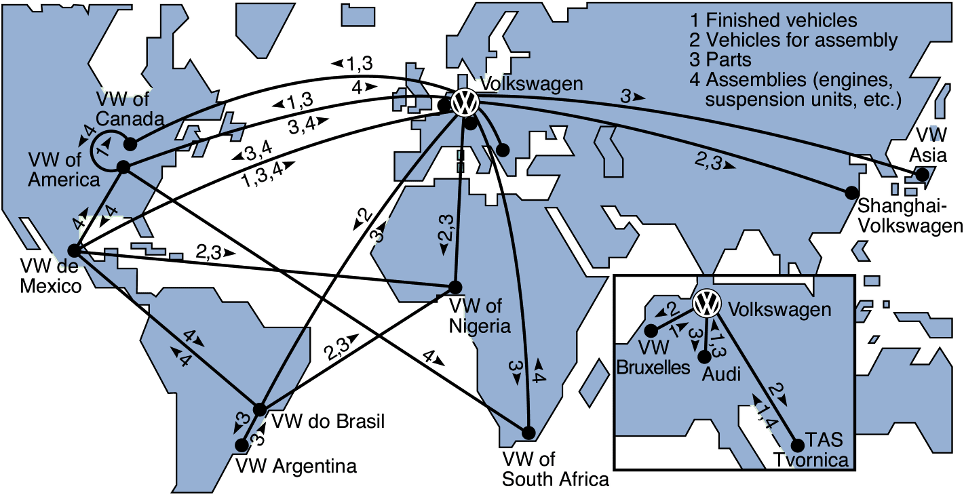
Worldwide Distribution of Volkswagens and Parts
Figure 8.4

Slide 39
Service Location Strategy
Purchasing power of customer-drawing area
Service and image compatibility with demographics of the customer-drawing area
Competition in the area
Quality of the competition
Uniqueness of the firm’s and competitors’ locations
Physical qualities of facilities and neighboring businesses
Operating policies of the firm
Quality of management

Slide 40
Location Strategies
Service/Retail/Professional Location Goods-Producing Location
Revenue Focus Cost Focus
Volume/revenue
Drawing area; purchasing power
Competition; advertising/pricing
Physical quality
Parking/access; security/lighting; appearance/image
Cost determinants
Rent
Management caliber
Operations policies (hours, wage rates)
Tangible costs
Transportation cost of raw material
Shipment cost of finished goods
Energy and utility cost; labor; raw material; taxes, and so on
Intangible and future costs
Attitude toward union
Quality of life
Education expenditures by state
Quality of state and local government

Slide 41
Location Strategies
Service/Retail/Professional Location Goods-Producing Location
Techniques Techniques
Regression models to determine importance of various factors
Factor-rating method
Traffic counts
Demographic analysis of drawing area
Purchasing power analysis of area
Center-of-gravity method
Geographic information systems
Transportation method
Factor-rating method
Locational break-even analysis
Crossover charts

Slide 42
Location Strategies
Service/Retail/Professional Location Goods-Producing Location
Assumptions Assumptions
Location is a major determinant of revenue
High customer-contact issues are critical
Costs are relatively constant for a given area; therefore, the revenue function is critical
Location is a major determinant of cost
Most major costs can be identified explicitly for each site
Low customer contact allows focus on the identifiable costs
Intangible costs can be evaluated

Slide 43
How Hotel Chains Select Sites
Location is a strategically important decision in the hospitality industry
La Quinta started with 35 independent variables and worked to refine a regression model to predict profitability
The final model had only four variables
Cost of construction
Median income levels
State population per inn
Location of nearby colleges
r² = .51
51% of the profitability is predicted by just these four variables!

Slide 44
The Call Center Industry
Requires neither face-to-face contact nor movement of materials
Has very broad location options
Traditional variables are no longer relevant
Cost and availability of labor may drive location decisions

Slide 45
Geographic Information Systems (GIS)
Important tool to help in location analysis
Enables more complex demographic analysis
Available data bases include
Detailed census data
Detailed maps
Utilities
Geographic features
Locations of major services

Slide 46
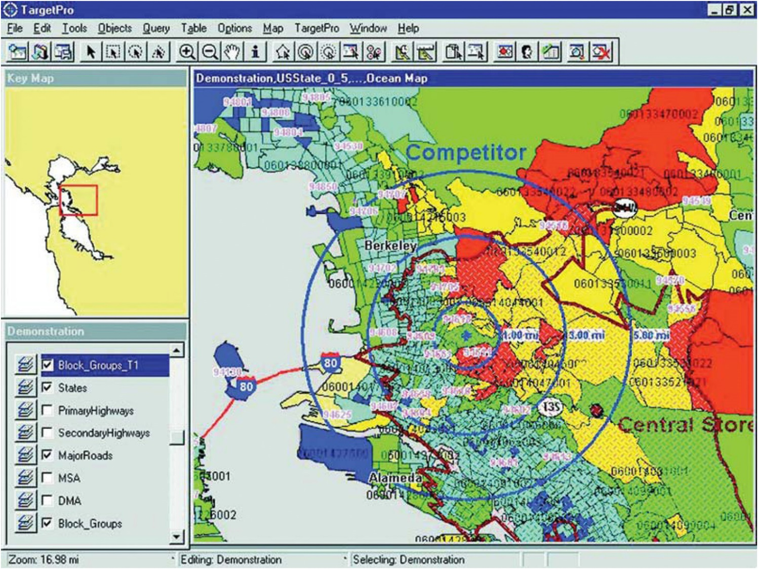
Geographic Information Systems (GIS)

Slide 47
End

