Slide 1
Utility Theory

Slide 2
EMV vs. Utility
We have focused on the EMV criterion for making decisions under risk.
However, there are many occasions in which people make decisions that would appear to be inconsistent with the EMV criterion.
Some examples of this type of decisions:
People buy insurance.
A person may decide to settle out of court rather than go to trial even if the expected value of going to trial is greater than the proposed settlement.
A person buys lottery ticket even thought the expected returns are negative.
Casino games have a negative expected return for players
A businessperson may rule out one potential decision because it could bankrupt the firm if things go bad, even though the expected return for this decision is better than of all other alternatives.
Regents Park Publishers

Slide 3
EMV vs. Utility
Why do people make decisions that don’t maximize their EMV? They do this because the monetary value is not always the true indicator of the overall value of the decision.
The overall worth of a particular outcome is called UTILITY.
Rational people make decisions that maximize the expected utility. The Utility values replace the EMV’s for the purposes of decision making.
At times, the monetary value is a good indicator of utility, but this is not always the case. This is particularly true when some of the values involve extremely large payoffs or extremely large losses.
EMV is not always the best decision-making approach. One way to incorporate one’s attitudes towards risk is through the utility assessment. Utility assessment assigns the worst outcome a utility of 0 and the best outcome a utility of 1.
When one is indifferent, the expected utilities are equal:
Expected utility of alternative 2 = Expected utility of alternative 1
Regents Park Publishers

Slide 4
Gamble
Suppose that you hold a lottery ticket. Five minutes from now a fair coin is to be flipped, and if it comes up tails, you could win $5,000,000. If it comes head, you will nothing.
Just a moment ago a wealthy person offered you $2,000,000 for your ticket. This is a legitimate offer.
Just think $2 million for sure instead of 50% chance of nothing.
The EMV method would point to holding on to your ticket. However, most people would opt on for the sure thing.
$2,000,000
Accept Offer
$0
Reject Offer
Heads (0.5)
Tails (0.5)
$5,000,000
Regents Park Publishers

Slide 5
Utility Curve
Utility curve is a graph that plots utility value versus monetary value.
Regents Park Publishers

Slide 6
Subjective Utility Curve
Utility Curve may look like that. It is a subjective assessment of the indifference points.
1.0
0.9
0.8
0.7
Utility
0.6
0.5
0.4
0.3
0.2
0.1
$0
$1,000
$3,000
$5,000
$7,000
$10,000
Monetary value
Regents Park Publishers

Slide 7
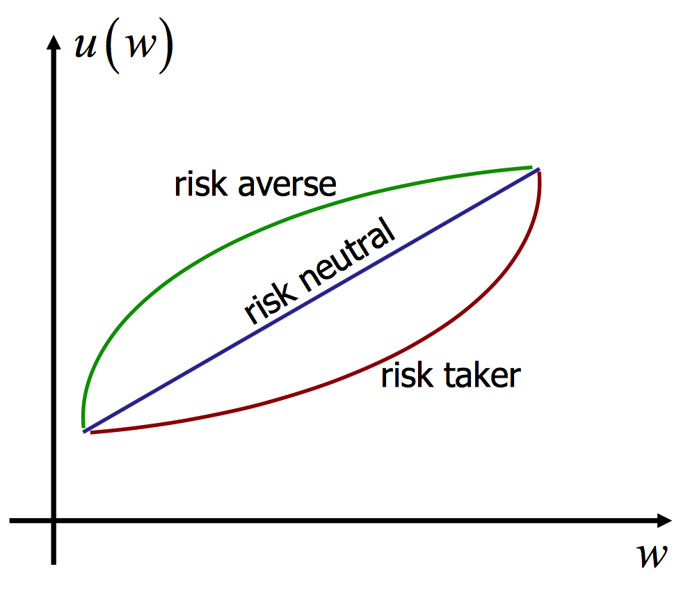
Preference for Risk
The shape of a person’s utility curve depends on many factors.
Utility
Monetary value
Regents Park Publishers

Slide 8
Risk Profiles
Risk averse is a decision maker who gets less utility or pleasure from a greater risk and tends to avoid situations in which high losses may occur. As monetary value increases at stake increases the rate of utility grow slows.
Risk taker: this decision maker gets more utility from the greater risk and higher potential payoff. As monetary value increases, the personal utility increases at an increasing rate.
Risk indifferent: the utility for this person is shown as a straight line.
The shape of a person’s utility curve depends on the specific decisions being considered, the monetary values being involved in the situation, the person’s psychological frame of mind, and how the person feels about the future. You may have one utility curve for some situations you face and completely different curves for others.
Regents Park Publishers

Slide 9
Utility Theory
End
Regents Park Publishers

