Slide 1
Numerical Representations

Slide 2
Content
After completing this Learning Module, you should be able to:
Compute and interpret the mean, median, and mode for a set of data
Compute the range, variance, and standard deviation and know what these values mean
Compute and explain the coefficient of variation and
z scores
Use numerical measures along with graphs, charts, and tables to describe data

Slide 3
Learning Module Topics
Measures of Center and Location
  Mean, median, mode, geometric mean, midrange
Other measures of Location
  Weighted mean, percentiles, quartiles
Measures of Variation
  Range, interquartile range, variance and standard deviation, coefficient of variation

Slide 4
Summary Measures
Describing Data Numerically
Center and Location
Other Measures of Location
Variation
Mean
Range
Percentiles
Median
Interquartile Range
Quartiles
Mode
Variance
Weighted Mean
Standard Deviation
Coefficient of Variation

Slide 5
Measures of Center and Location
Overview
Center and Location
Mean
Median
Mode
Weighted Mean

Slide 6
Mean (Arithmetic Average)
The Mean is the arithmetic average of data values
  Sample mean
  Population mean
n = Sample Size
N = Population Size

Slide 7
Mean (Arithmetic Average)
(continued)
The most common measure of central tendency
Mean = sum of values divided by the number of values
Affected by extreme values (outliers)
0 1 2 3 4 5 6 7 8 9 10
0 1 2 3 4 5 6 7 8 9 10
Mean = 3
Mean = 4

Slide 8
Median
Not affected by extreme values
In an ordered array, the median is the “middle” number
  If n or N is odd, the median is the middle number
  If n or N is even, the median is the average of the two middle numbers
0 1 2 3 4 5 6 7 8 9 10
0 1 2 3 4 5 6 7 8 9 10
Median = 3
Median = 3

Slide 9
Mode
A measure of central tendency
Value that occurs most often
Not affected by extreme values
Used for either numerical or categorical data
There may may be no mode
There may be several modes
0 1 2 3 4 5 6 7 8 9 10 11 12 13 14
0 1 2 3 4 5 6
Mode = 5
No Mode

Slide 10
Weighted Mean
Used when values are grouped by frequency or relative importance
Example: Sample of 26 Repair Projects
Weighted Mean Days to Complete:
Days to Complete | Frequency
5 | 4
6 | 12
7 | 8
8 | 2

Slide 11
Review Example
Five houses on a hill by the beach
House Prices:
$2,000,000
500,000
300,000
100,000
100,000

Slide 12
Summary Statistics
Data Analysis in Excel
House Prices:
$2,000,000
500,000
300,000
100,000
100,000
Sum 3,000,000
Mean: ($3,000,000/5)
= $600,000
Median: middle value of ranked data
= $300,000
Mode: most frequent value
= $100,000

Slide 13
Which measure of location is the “best”?
Mean is generally used, unless extreme values (outliers) exist
Then median is often used, since the median is not sensitive to extreme values.
  Example: Median home prices may be reported for a region – less sensitive to outliers

Slide 14
Shape of a Distribution
Describes how data is distributed
Symmetric or skewed
Left-Skewed
Symmetric
Right-Skewed
Mean < Median < Mode
Mean = Median = Mode
Mode < Median < Mean
(Longer tail extends to left)
(Longer tail extends to right)

Slide 15
Other Location Measures
Skip these measures
Other Measures of Location
Percentiles
Quartiles
The p^{th} percentile in a data array:
p% are less than or equal to this value
(100 – p)% are greater than or equal to this value
(where 0 ≤ p ≤ 100)
1st quartile = 25th percentile
2nd quartile = 50th percentile
    = median
3rd quartile = 75th percentile

Slide 16
Percentiles
The p^{th} percentile in an ordered array of n values is the value in i^{th} position, where
Example: The 60th percentile in an ordered array of 19 values is the value in 12th position:

Slide 17
Quartiles
Quartiles split the ranked data into 4 equal groups
25%
25%
25%
25%
Q1
Q2
Q3
Example: Find the first quartile
Sample Data in Ordered Array: 11 12 13 16 16 17 18 21 22
(n = 9)
Q1 = 25th percentile, so find the (9+1) = 2.5 position
so use the value half way between the 2nd and 3rd values,
so Q1 = 12.5
25
100

Slide 18
Measures of Variation
Variation
Range
Variance
Standard Deviation
Coefficient of Variation
Interquartile
Range
Population
Variance
Population
Standard
Deviation
Sample
Variance
Sample
Standard
Deviation

Slide 19
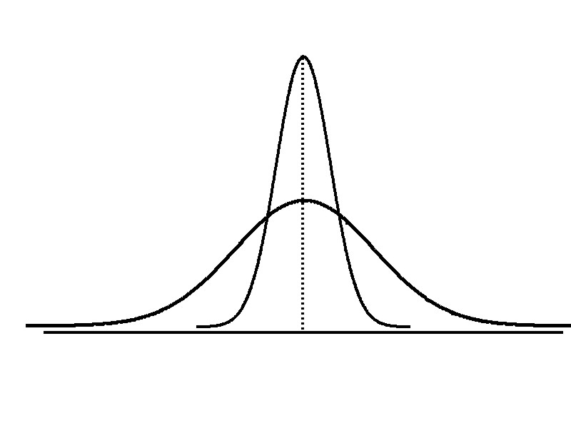
Variation
Measures of variation give information on the spread or variability of the data values.
Same center,
Different spread

Slide 20
Range
Simplest measure of variation
Difference between the largest and the smallest observations:
Range = x_{maximum} – x_{minimum}
Example:
1 2 3 4 5 6 7 8 9 10 11 12 13 14
Range = 14 - 1 = 13

Slide 21
Disadvantages of the Range
Ignores the way in which data are distributed
Sensitive to outliers
7 8 9 10 11 12
7 8 9 10 11 12
Range = 12 - 7 = 5
Range = 12 - 7 = 5
1,1,1,1,1,1,1,1,1,1,1,2,2,2,2,2,2,2,2,3,3,3,3,4,5
Range = 5 - 1 = 4
1,1,1,1,1,1,1,1,1,1,1,2,2,2,2,2,2,2,2,3,3,3,3,4,120
Range = 120 - 1 = 119

Slide 22
Interquartile Range
Skip this measure
Can eliminate some outlier problems by using the interquartile range
Eliminate some high-and low-valued observations and calculate the range from the remaining values.
Interquartile range = 3rd quartile – 1st quartile

Slide 23
Variance
Average of squared deviations of values from the mean
  Sample variance:
  Population variance:

Slide 24
Standard Deviation
Most commonly used measure of variation
Shows variation about the mean
Has the same units as the original data
  Sample standard deviation:
  Population standard deviation:

Slide 25
Coefficient of Variation
Measures relative variation
Always in percentage (%)
Shows variation relative to mean
Is used to compare two or more sets of data measured in different units
Population Sample

Slide 26
Comparing Coefficient of Variation
Stock A:
  Average price last year = $50
  Standard deviation = $5
Stock B:
  Average price last year = $100
  Standard deviation = $5
Both stocks have the same standard deviation, but stock B is less variable relative to its price

Slide 27
The Empirical Rule
If the data distribution is bell-shaped, then the interval:
contains about 68% of the values in the population or the sample
68%

Slide 28
The Empirical Rule
contains about 95% of the values in the population or the sample
contains about 99.7% of the values in the population or the sample
95%
99.7%

Slide 29
Using Microsoft Excel
Descriptive Statistics are easy to obtain from Microsoft Excel
  Use menu choice:
  Data / Data Analysis / Descriptive Statistics
  Enter details in dialog box

Slide 30
Summary
Described measures of center and location
  Mean, median, mode, geometric mean, midrange
Described measure of variation
  Range, interquartile range, variance,
  standard deviation, coefficient of variation

Slide 31
CSUSM
T1LM3
End

