Slide 1
CSUSM
Data Analytics
T1LM 2
Data Collection & Representation

Slide 2
Learning Module Goals
After completing this Learning Module, you should be able to:
Describe key data collection methods
Know key definitions:
  ♦Population vs. Sample ♦Primary vs. Secondary data types
  ♦Qualitative vs. Qualitative data ♦Time Series vs. Cross-Sectional data
Explain the difference between descriptive and
inferential statistics
Describe different sampling methods

Slide 3
Tools of Business Statistics
Descriptive statistics
  Collecting, presenting, and describing data
Inferential statistics
  Drawing conclusions and/or making decisions concerning a population based only on sample data

Slide 4
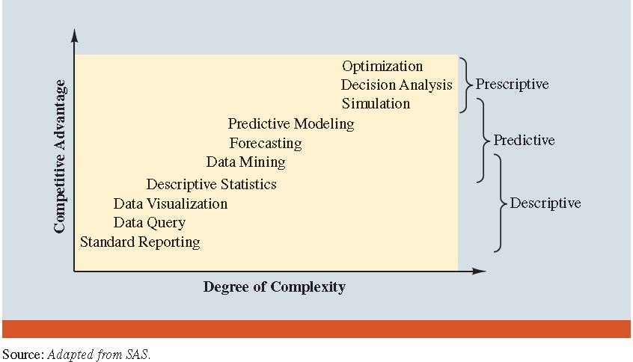
Tools of Business Statistics
Scope of Business Analytics
Scope of Business Statistics

Slide 5
Market Research Process
Burke and Associates

Slide 6
Descriptive Statistics
Collect data
  e.g. Survey, Observation,
  Experiments
Present data
  e.g. Charts and graphs
Characterize data
  e.g. Sample mean =

Slide 7


Data Sources
Primary
Data Collection
Secondary
Data Compilation
Print or Electronic and WEB
Observation
Survey
Experimentation

Slide 8
Populations and Samples
A Population is the set of all items or individuals of interest
  Examples: All likely voters in the next election
All parts produced today
All sales receipts for November
A Sample is a subset of the population
  Examples: 1000 voters selected at random for interview
        A few parts selected for destructive testing
        Every 100th receipt selected for audit

Slide 9
Population vs. Sample
Population
Sample
a b c d
ef gh i jk l m n
o p q rs t u v w
x y z
b c
g i n
o r u
y

Slide 10
Why Sample?
Less time consuming than a census
Less costly to administer than a census
It is possible to obtain statistical results of a sufficiently high precision based on samples.

Slide 11
Sampling Techniques
Samples
Non-Probability Samples
Probability Samples
Simple
Random
Systematic
Judgement
Convenience
Cluster
Stratified

Slide 12
Statistical Sampling
Items of the sample are chosen based on known or calculable probabilities
Probability Samples
Simple
Random
Stratified
Systematic
Cluster

Slide 13
Simple Random Samples
Every individual or item from the population has an equal chance of being selected
Selection may be with replacement or without replacement
Samples can be obtained from a table of random numbers or computer random number generators

Slide 14
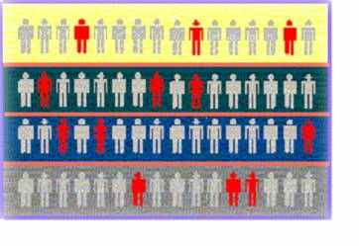

Stratified Samples
Population divided into subgroups (called strata) according to some common characteristic
Simple random sample selected from each subgroup
Samples from subgroups are combined into one
Population
Divided
into 4
strata
Sample

Slide 15
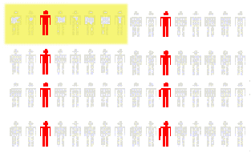
Systematic Samples
Decide on sample size: n
Divide frame of N individuals into groups of k individuals: k=N/n
Randomly select one individual from the 1st group
Select every k^{th} individual thereafter
N = 64
n = 8
k = 8
First Group

Slide 16
Cluster Samples
Population is divided into several “clusters,” each representative of the population
A simple random sample of clusters is selected
  All items in the selected clusters can be used, or items can be chosen from a cluster using another probability sampling technique
Population divided into 16 clusters.
Randomly selected clusters for sample

Slide 17
Key Definitions
A population is the entire collection of things under consideration
  A parameter is a summary measure computed to describe a characteristic of the population
A sample is a portion of the population selected for analysis
  A statistic is a summary measure computed to describe a characteristic of the sample

Slide 18
Inferential Statistics
Making statements about a population by examining sample results
Sample statistics Population parameters
(known) Inference (unknown, but can
be estimated from
sample evidence)

Slide 19
Inferential Statistics
Drawing conclusions and/or making decisions concerning a population based on sample results.
Estimation
  e.g.: Estimate the population mean weight using the sample mean weight
Hypothesis Testing
  e.g.: Use sample evidence to test the claim that the population mean weight is 120 pounds

Slide 20
Data Types
Data
Qualitative
(Categorical)
Quantitative
(Numerical)
Discrete
Continuous
Examples:
Marital Status
Political Party
Eye Color
(Defined categories)
Examples:
Number of Children
Defects per hour
(Counted items)
Examples:
Weight
Voltage
(Measured characteristics)

Slide 21
Data Types
Time Series Data
  Ordered data values observed over time
Cross Section Data
  Data values observed at a fixed point in time

Slide 22
Data Types
 | Sales (in $1000’s)
 | 2003 | 2004 | 2005 | 2006
Atlanta | 435 | 460 | 475 | 490
Boston | 320 | 345 | 375 | 395
Cleveland | 405 | 390 | 410 | 395
Denver | 260 | 270 | 285 | 280
Time Series Data
Cross Section Data

Slide 23
Frequency Distributions
What is a Frequency Distribution?
A frequency distribution is a list or a table …
containing the values of a variable (or a set of ranges within which the data falls) ...
and the corresponding frequencies with which each value occurs (or frequencies with which data falls within each range)

Slide 24
Why Use Frequency Distributions?
A frequency distribution is a way to summarize data
The distribution condenses the raw data into a more useful form...
and allows for a quick visual interpretation of the data

Slide 25

Frequency Distribution:
Discrete Data
Discrete data: possible values are countable
Example: An advertiser asks 200 customers how many days per week they read the daily newspaper.
Number of days read | Frequency
0 | 44
1 | 24
2 | 18
3 | 16
4 | 20
5 | 22
6 | 26
7 | 30
Total | 200

Slide 26
Relative Frequency
Relative Frequency: What proportion is in each category?
Number of days read | Frequency | Relative Frequency
0 | 44 | .22
1 | 24 | .12
2 | 18 | .09
3 | 16 | .08
4 | 20 | .10
5 | 22 | .11
6 | 26 | .13
7 | 30 | .15
Total | 200 | 1.00
22% of the people in the sample report that they read the newspaper 0 days per week

Slide 27
Frequency Distribution:
Continuous Data
Continuous Data: may take on any value in some interval
Example: A manufacturer of insulation randomly selects 20 winter days and records the daily high temperature
24, 35, 17, 21, 24, 37, 26, 46, 58, 30,
32, 13, 12, 38, 41, 43, 44, 27, 53, 27
(Temperature is a continuous variable because it could
be measured to any degree of precision desired)

Slide 28
Grouping Data by Classes
  Sort raw data in ascending order:
12, 13, 17, 21, 24, 24, 26, 27, 27, 30, 32, 35, 37, 38, 41, 43, 44, 46, 53, 58
Find range: 58 - 12 = 46
Select number of classes: 5 (usually between 5 and 20)
Compute class width: 10 (46/5 then round off)
Determine class boundaries:10, 20, 30, 40, 50
Compute class midpoints: 15, 25, 35, 45, 55
Count observations & assign to classes

Slide 29
Frequency Distribution Example
Data in ordered array:
12, 13, 17, 21, 24, 24, 26, 27, 27, 30, 32, 35, 37, 38, 41, 43, 44, 46, 53, 58
Frequency Distribution
Class Frequency
Relative
Frequency
10 but under 20 3 .15
20 but under 30 6 .30
30 but under 40 5 .25
40 but under 50 4 .20
50 but under 60 2 .10
Total 20 1.00

Slide 30
Histograms
The classes or intervals are shown on the horizontal axis
frequency is measured on the vertical axis
Bars of the appropriate heights can be used to represent the number of observations within each class
Such a graph is called a histogram

Slide 31
Histogram Example
Data in ordered array:
12, 13, 17, 21, 24, 24, 26, 27, 27, 30, 32, 35, 37, 38, 41, 43, 44, 46, 53, 58
No gaps between bars, since continuous data
Class Midpoints

Slide 32
Graphing Categorical Data
Categorical Data
Pie Charts
Bar Charts
Pareto Diagram

Slide 33
Bar and Pie Charts
Bar charts and Pie charts are often used for qualitative (category) data
Height of bar or size of pie slice shows the frequency or percentage for each category

Slide 34
Pie Chart Example
Current Investment Portfolio
Investment Amount Percentage
Type (in thousands $)
Stocks 46.5 42.27
Bonds 32.0 29.09
CD 15.5 14.09
Savings 16.0 14.55
Total 110 100
Savings
15%
Stocks
42%
CD 14%
(Variables are Qualitative)
Bonds 29%
Percentages are rounded to the nearest percent

Slide 35
Bar Chart Example

Slide 36
Pareto Diagram Example
% invested in each category (bar graph)
cumulative % invested (line graph)

Slide 37
Bar Chart Example
Number of days read | Frequency
0 | 44
1 | 24
2 | 18
3 | 16
4 | 20
5 | 22
6 | 26
7 | 30
Total | 200

Slide 38
Tabulating and Graphing
Multivariate Categorical Data
Investment in thousands of dollars
Investment Investor A Investor B Investor C Total
Category
Stocks 46.5 55 27.5 129
Bonds 32.0 44 19.0 95
CD 15.5 20 13.5 49
Savings 16.0 28 7.0 51
Total 110.0 147 67.0 324

Slide 39
Tabulating and Graphing
Multivariate Categorical Data
(continued)
Side by side charts

Slide 40
Side-by-Side Chart Example
Sales by quarter for three sales territories:

Slide 41
Line Charts and
Scatter Diagrams
Line charts show values of one variable vs. time
  Time is traditionally shown on the horizontal axis
Scatter Diagrams show points for bivariate data
  one variable is measured on the vertical axis and the other variable is measured on the horizontal axis

Slide 42
Line Chart Example
Year | Inflation Rate
1985 | 3.56
1986 | 1.86
1987 | 3.65
1988 | 4.14
1989 | 4.82
1990 | 5.40
1991 | 4.21
1992 | 3.01
1993 | 2.99
1994 | 2.56
1995 | 2.83
1996 | 2.95
1997 | 2.29
1998 | 1.56
1999 | 2.21
2000 | 3.36
2001 | 2.85
2002 | 1.58

Slide 43
Scatter Diagram Example
Volume per day | Cost per day
23 | 125
26 | 140
29 | 146
33 | 160
38 | 167
42 | 170
50 | 188
55 | 195
60 | 200

Slide 44
Types of Relationships
Linear Relationships

Slide 45
Learning Module Summary
Reviewed key data collection methods
Introduced key definitions:
  ♦Population vs. Sample ♦Primary vs. Secondary data types
  ♦Qualitative vs. Qualitative data ♦Time Series vs. Cross-Sectional data
Examined descriptive vs. inferential statistics
Described different sampling techniques
Reviewed data types and measurement levels

Slide 46
Data Collections Examples
(continued)
License Plate Reader
Smart TV
Facial Recognition
Facebook
Google Tracking
Stores
Palantir
Alexa

Slide 47
CSUSM
T1LM2
End

